Slide 1

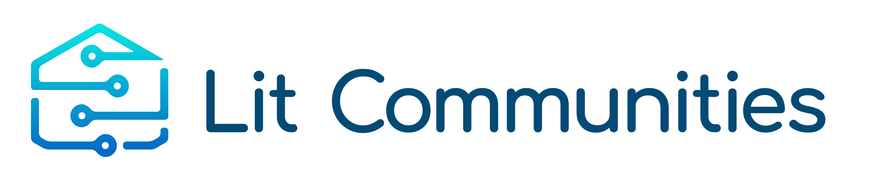
Kendall County
Broadband Town Hall
August 10, 2022

Slide 2
Next Steps - Strategic Actions
Partial middle mile build out in the central and southern areas of the County. This can be a phased build out starting with Rings 7, 9, 11, 12, and 13. Anchor institutions that would be served should be taken into consideration as well.
Discuss and determine the County’s interest in working with partners to establish a public private partnership that can help with operating and maintaining a municipal middle mile network and providing last mile services.
Marketing campaign to increase community engagement and participation in the survey.

Slide 3
Next Steps - Strategic Actions
Expand the number of stakeholders involved in bringing connectivity to Kendall County - the group should consist of public stakeholders and other industry sectors. The partner engagement and focus groups scheduled with ISP/telecom providers, utility providers, government entities, community non-profit organizations, K-12 and higher education institutions (particularly community colleges), the library system, healthcare industry, and business community representatives, the County Finance Committee, Emergency Services, and the County FEMA office will help broaden the number of stakeholders and beneficiaries of a municipal network.

Slide 4
Next Steps - Strategic Actions
Continue to refine the network design for middle mile- this involves outside plant engineers to perform a drive test to inspect poles, lines and ground conditions. This data will refine the mileage and aerial vs underground ratios as well as the financial model.
Pursue future funding opportunities by creating a capital stack to complete the determined build out strategy. All funding sources should be explored - federal and state grant opportunities and private funding.

Slide 5
Market Analysis
There are several Internet Service Providers (ISPs) in the County, providing different types of Internet connections: Fixed Broadband (DSL, VDSL, Cable Modem, Fiber Optic, and other Copper Wireline), Wireless Broadband (Mobile 5G, Satellite, and Fixed Wireless). However, only a few of them (AT&T, Comcast, and MetroNet Fiber) provide Fiber Optic and this service is mostly focused on the business segment of the County.
Many current ISP offering service
Consider building a Kendall County owned middle mile network
Available long-haul for middle mile network

Slide 6
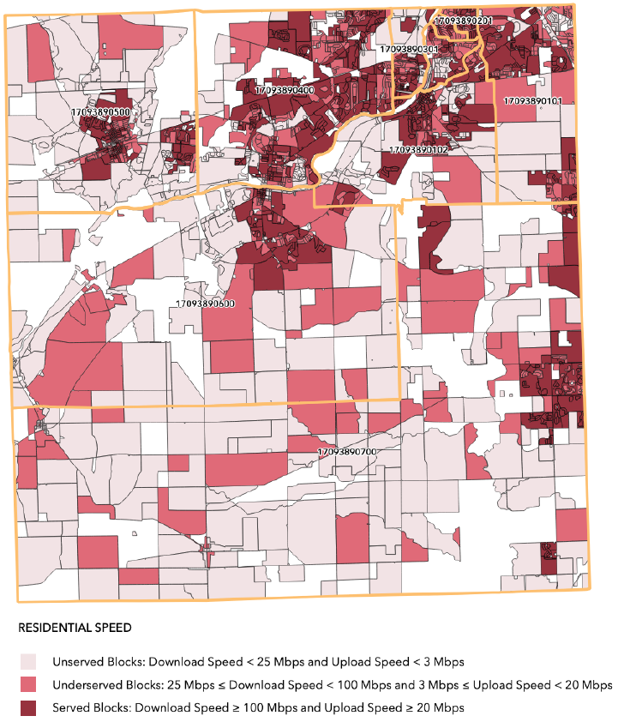
Market Analysis

Slide 7
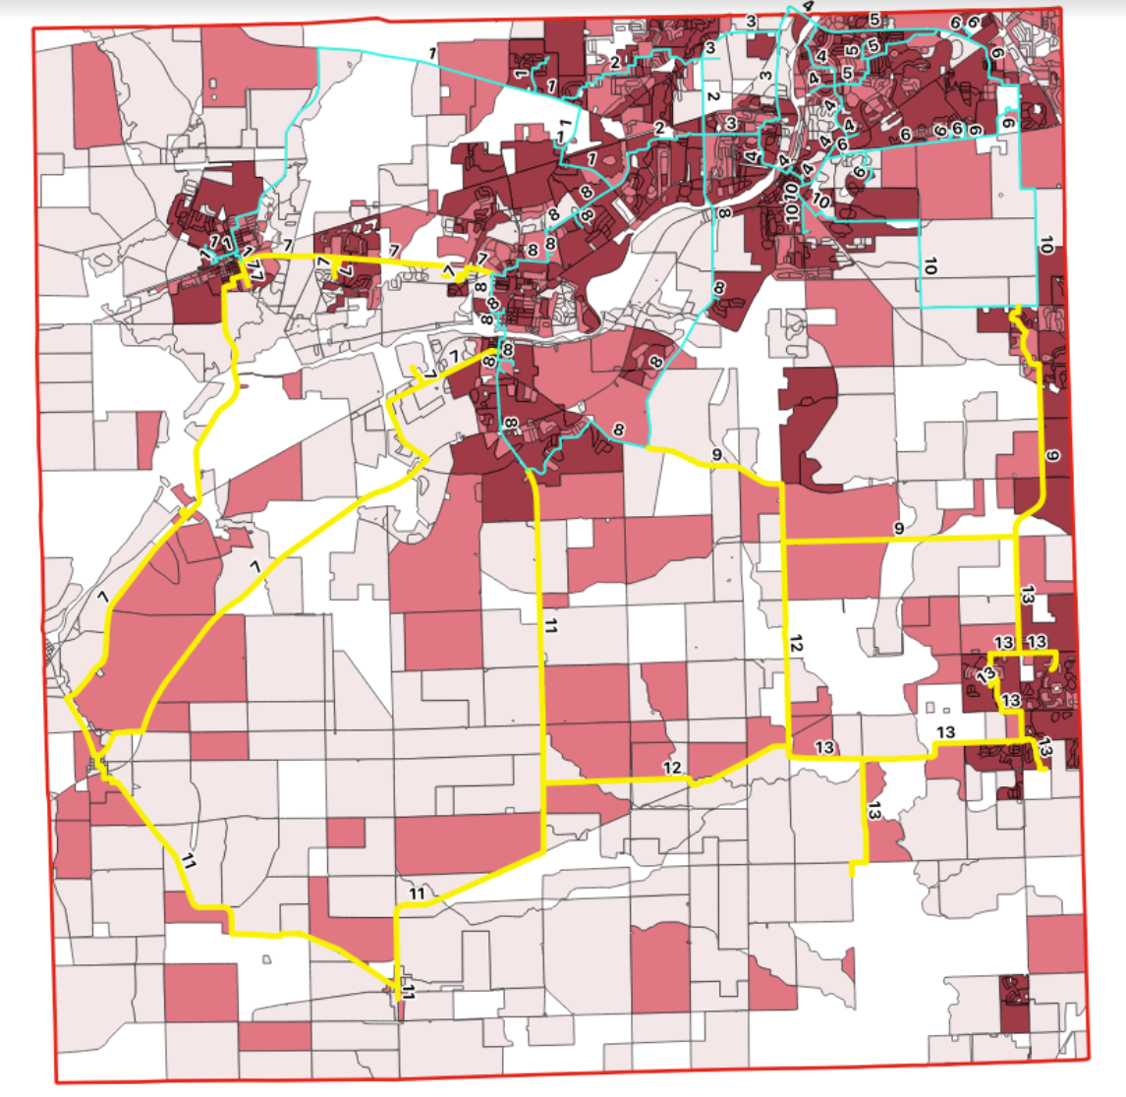
Market Analysis
Rings 7, 9, 11, 12 & 13 in yellow

Slide 8
Community Survey
The Kendall County Broadband Survey collected data from the community, both residents and businesses, in order to analyze the current status of the County's broadband.
Low response rate on initial push
Respondents show a strong interest in the development of broadband infrastructure
More surveys needed to ensure accuracy of survey data
Current surveys completed = 105

Slide 9
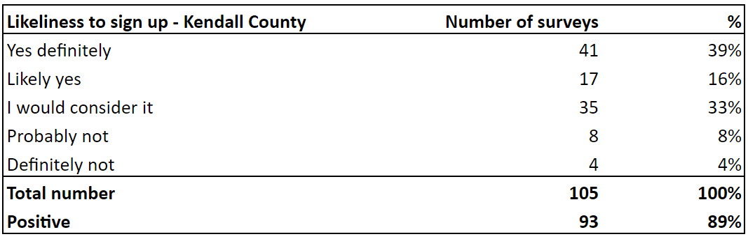
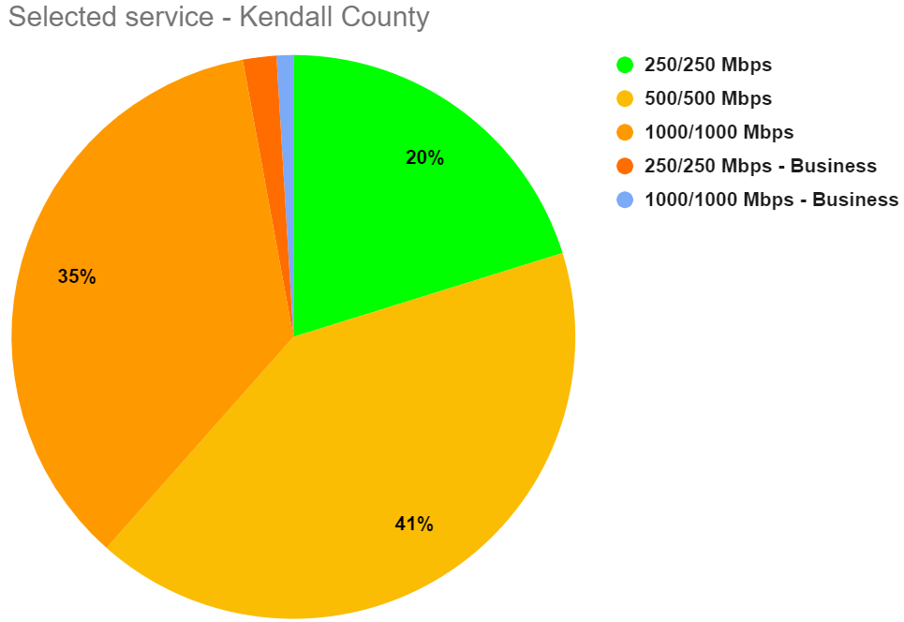
Community Survey

Slide 10
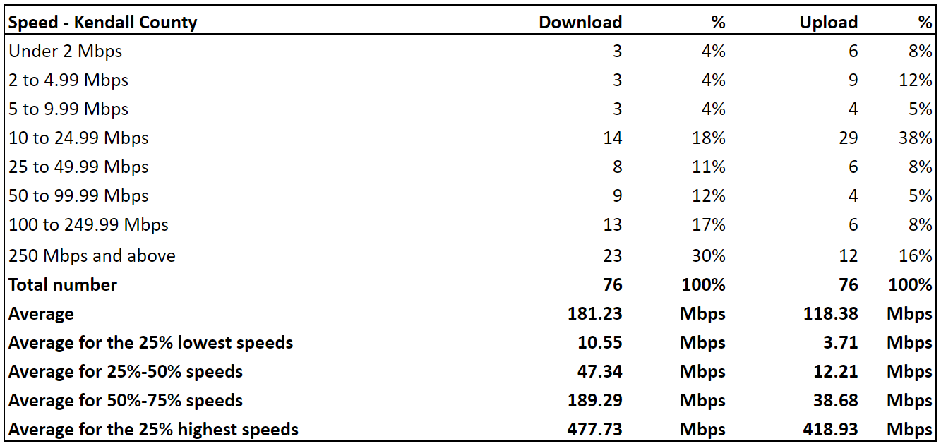
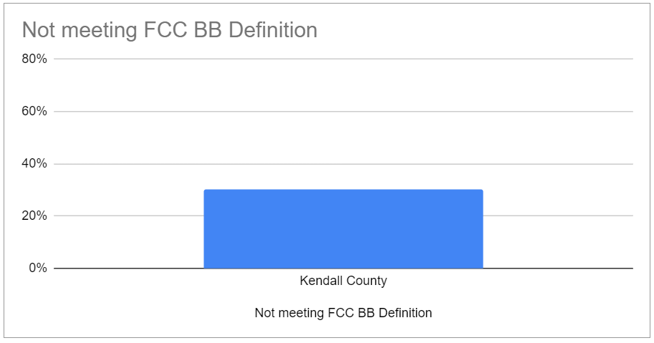
Community Survey

Slide 11
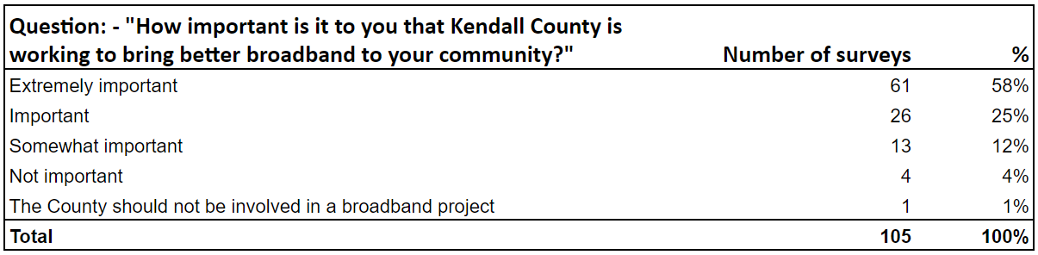
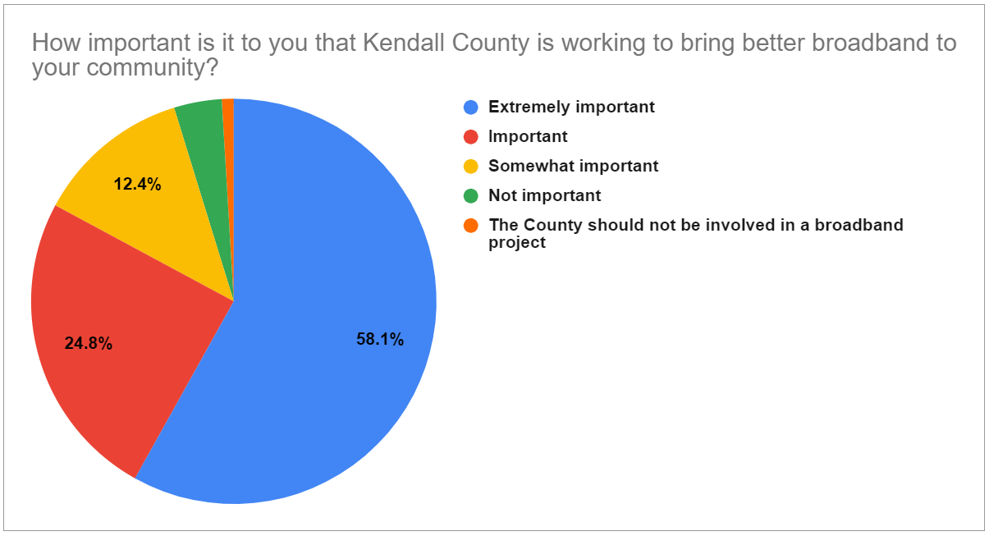
Community Survey

Slide 12
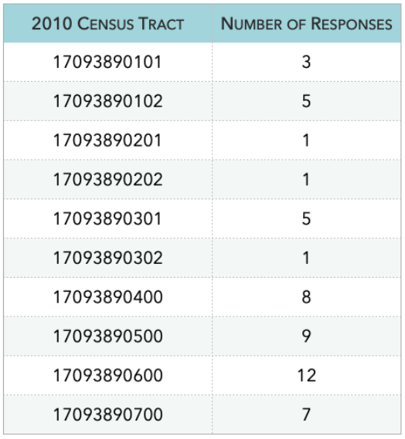
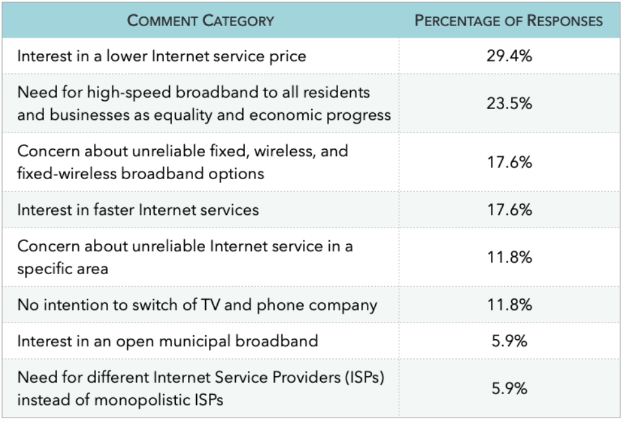
Community Survey

Slide 13
Preliminary Network Design – Middle Mile
Middle Mile
In the case of the preliminary middle mile design, a total of 97 anchor institutions have been connected through 13 closed network rings to add connectivity redundancy in the infrastructure (risk minimization of connectivity interruption due to potential hazards).
While the design does include some laterals for anchor institutions, less than 1% of the emergency services sites are on a lateral.

Slide 14
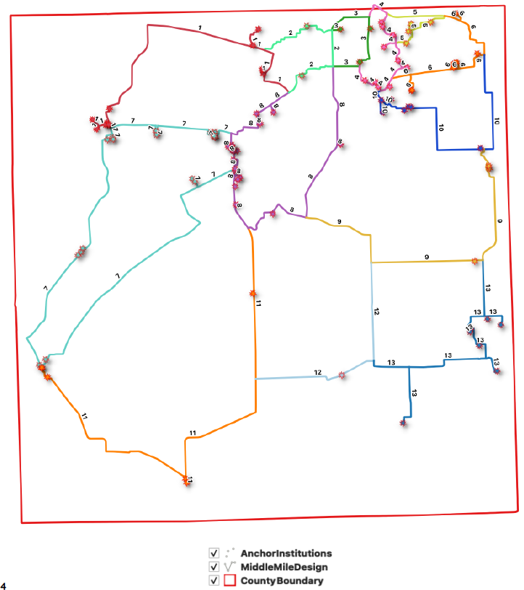
Preliminary Design – Middle Mile

Slide 15
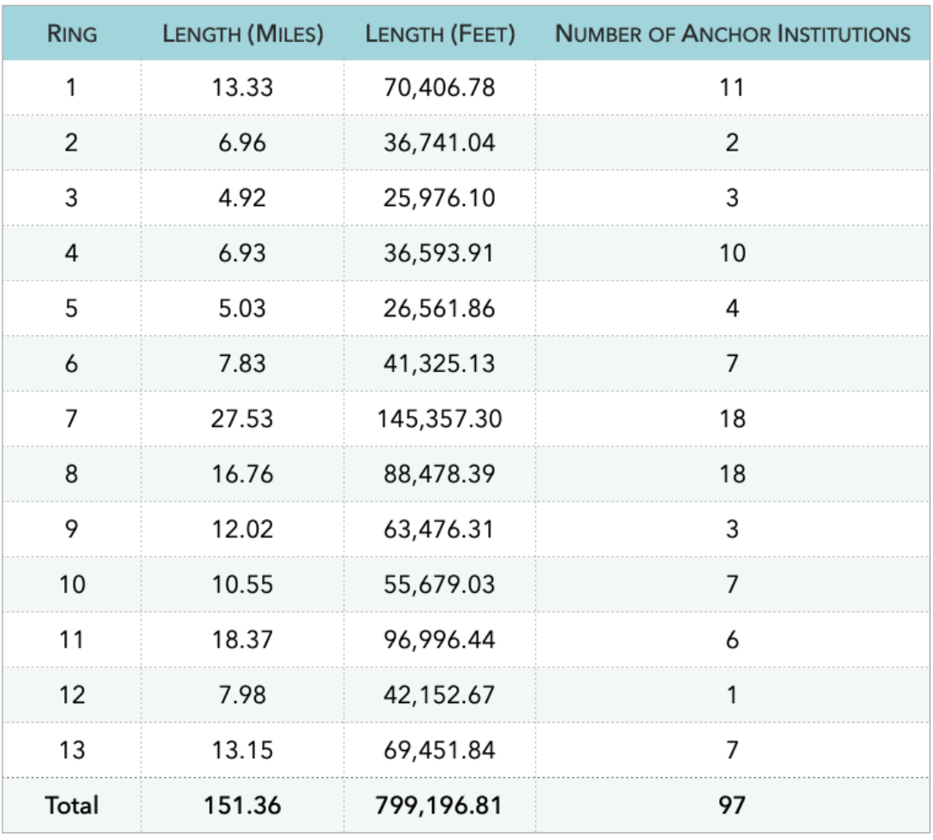
Preliminary Network Design – Middle Mile
Schools
Fire Stations
County Buildings
Township Buildings
City Buildings
Park District Buildings
Libraries
Police Departments
Sanitary Buildings
Forest Preserve Building

Slide 16
Preliminary Network Design – Last Mile
Last Mile
Kendall County provided Lit Communities with a total number of 52,641 addresses (residential and commercial), widely spread throughout the entire County extension, to be connected via the last mile.

Slide 17
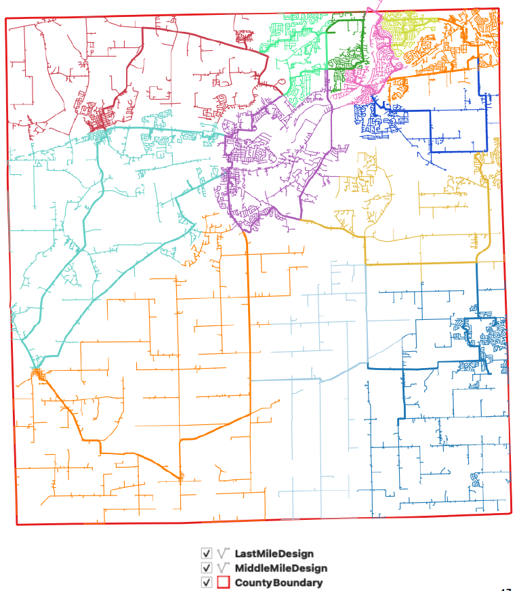
Preliminary Network Design – Last Mile

Slide 18
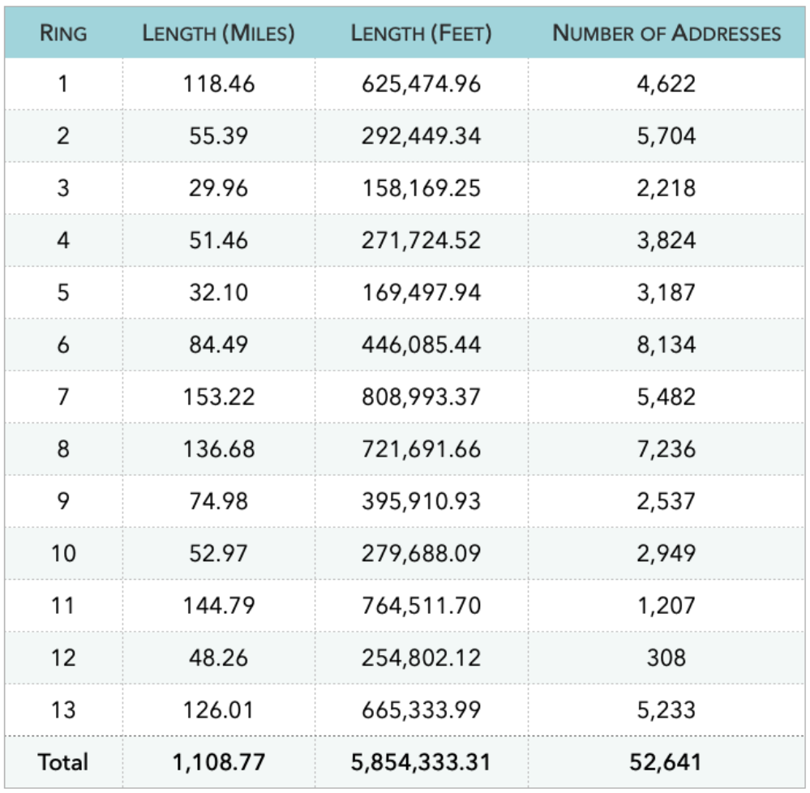
Preliminary Network Design – Last Mile

Slide 19
CRO & MREA
Lit Communities has developed a process to classify the network path as aerial or underground based on constructability. The route is evaluated by desktop with notes created using field software on a laptop or mobile device.

Slide 20
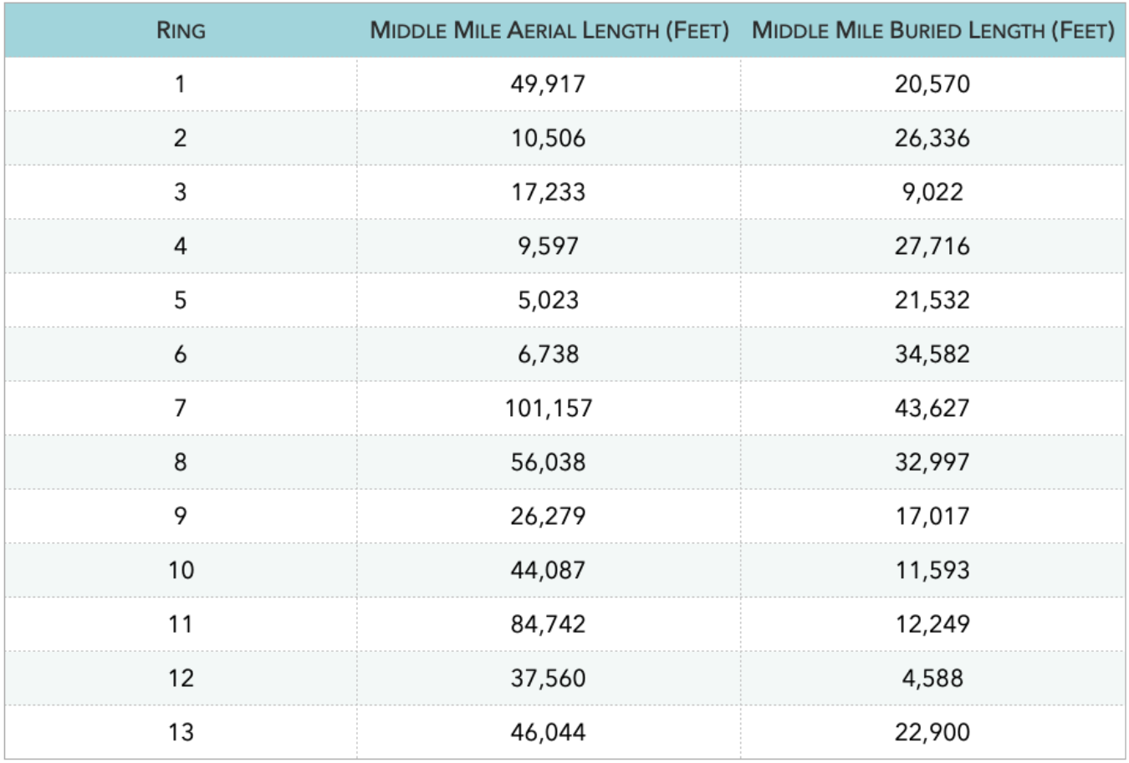
CRO & MREA – Middle Mile

Slide 21
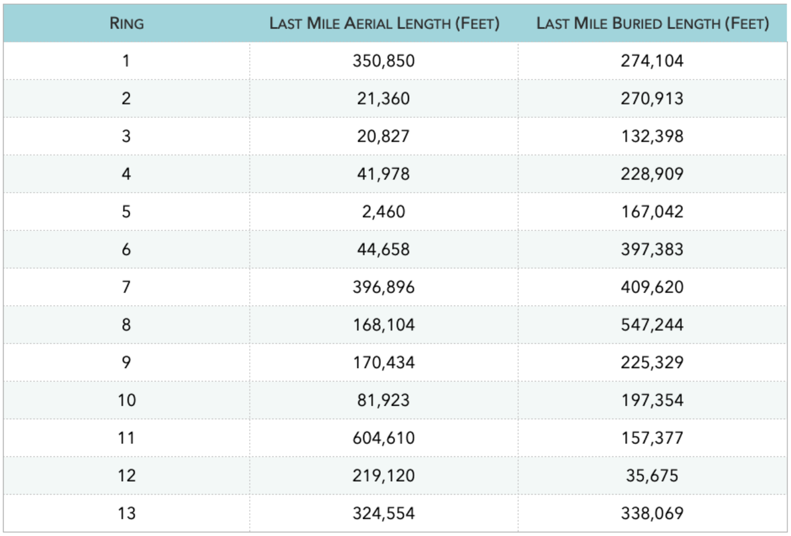
CRO & MREA – Last Mile

Slide 22
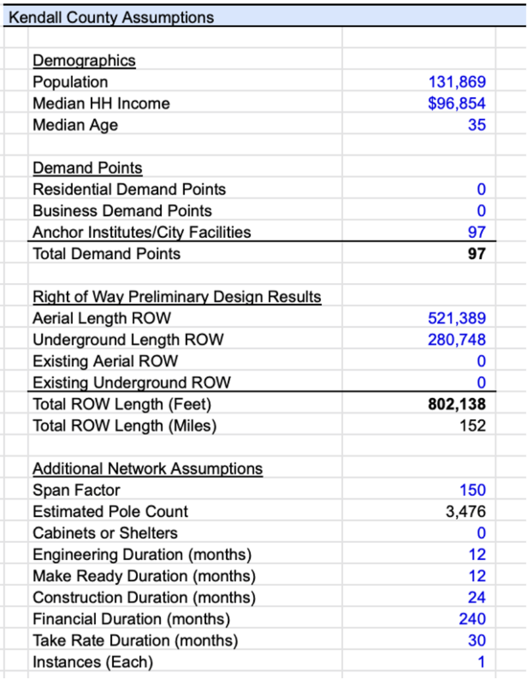
Financial Model – Middle Mile

Slide 23
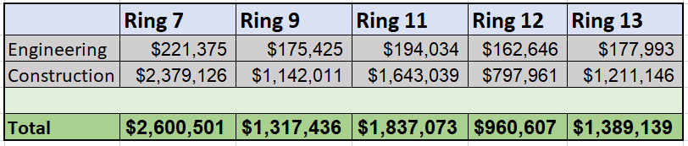
Financial Model – Middle Mile
Ring 7 Total = $2,600,501
Ring 9 Total = $1,317,436
Ring 11 Total = $1,837,073
Ring 12 Total = $960,607
Ring 13 Total = $1,389,139
Recommended Rings Total = $8,104,756

Slide 24
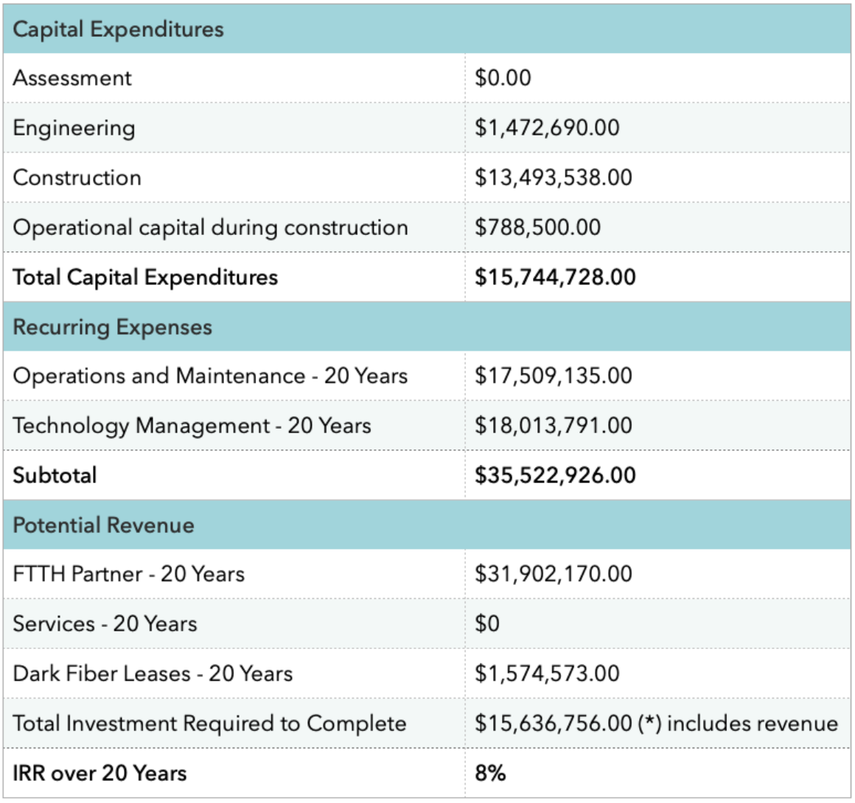
Financial Model – Middle Mile

Slide 25
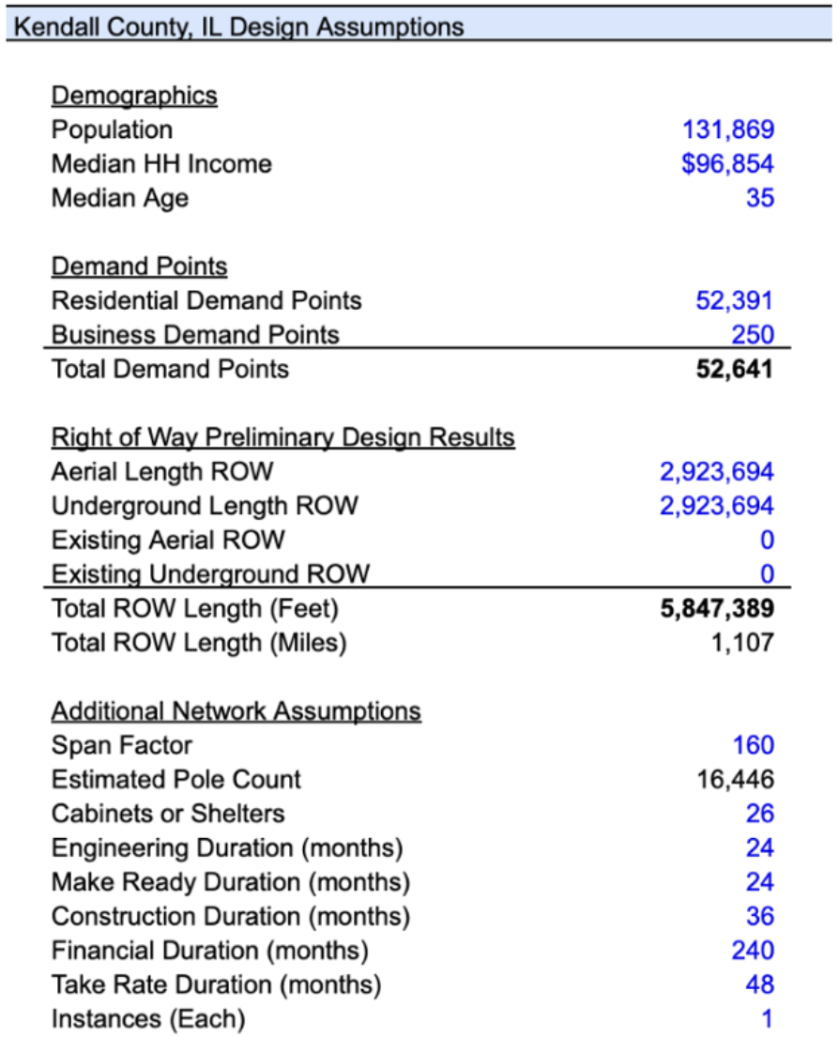
Financial Model – Last Mile

Slide 26
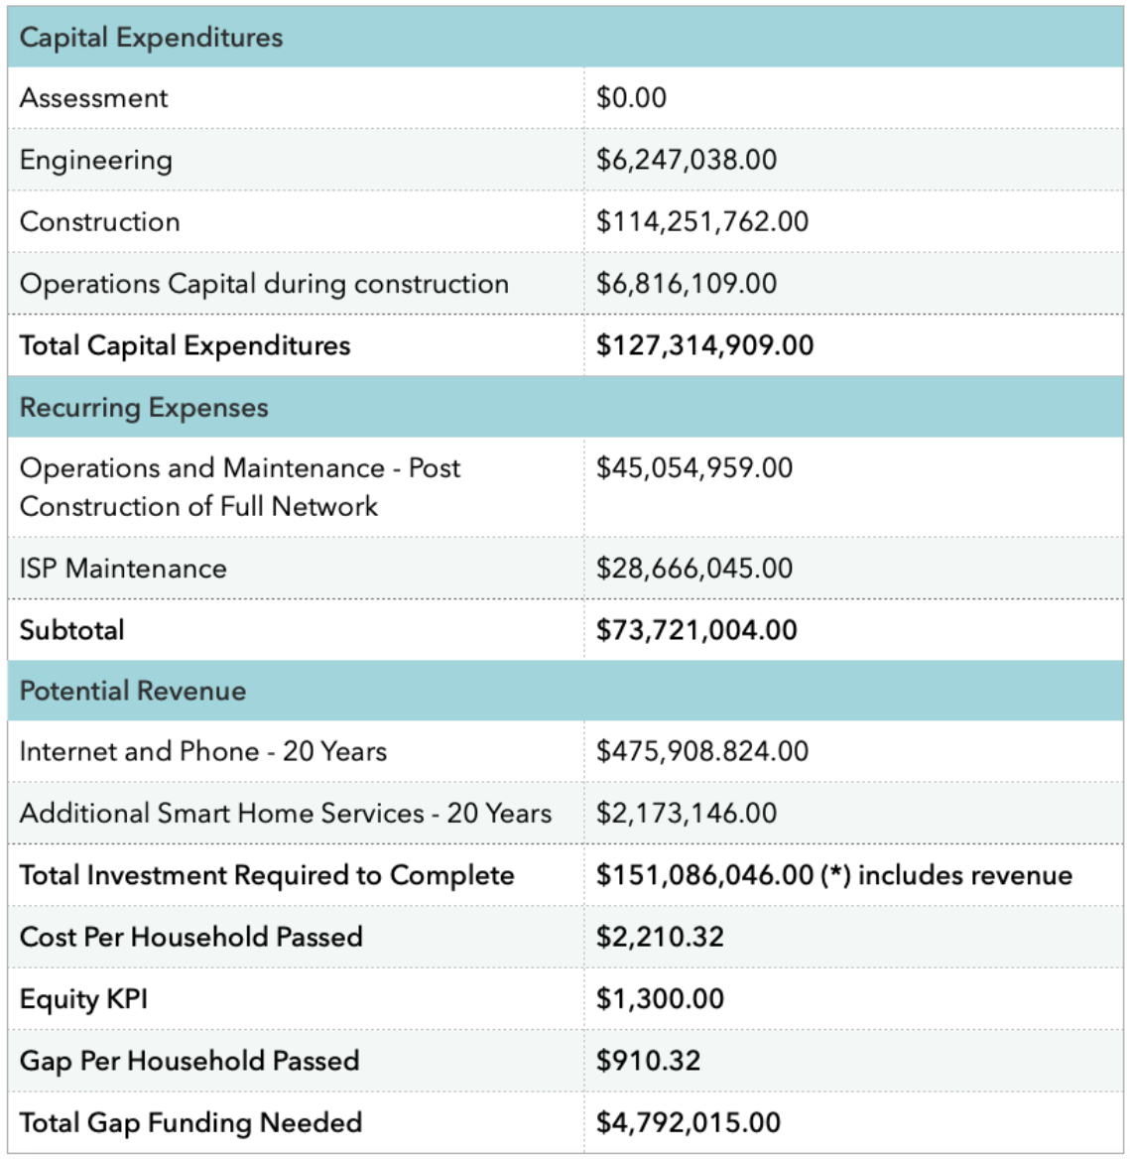
Financial Model – Last Mile

Slide 27
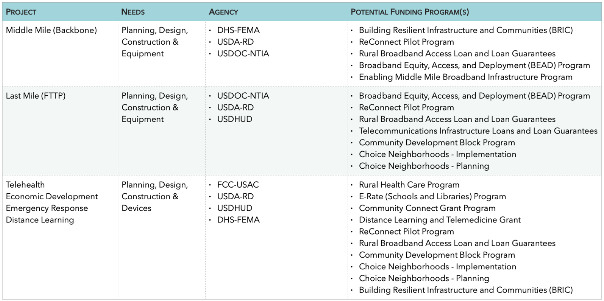
Grant Services

Slide 28
Next Steps - Recap
In order to enhance broadband connectivity, the County should consider building and owning a middle mile as the core network of the community. This will support current and future Internet Service Providers by reducing their capital and operational expenditures leading to an increase in market competition enhanced Internet service offerings and lower prices. Likewise, this network will connect anchor entities of Kendall County that serve the community ensuring Internet connectivity, security, and independence (from third parties) for data transmission.

Slide 29
Next Steps - Recap
Thank you.

