Slide 1

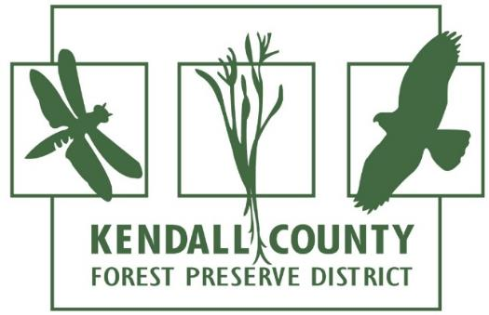



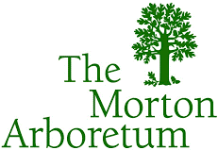



Is the Sale of Voluntary Carbon Credits a Potential Source of Income for your Agency’s Future?

Slide 2
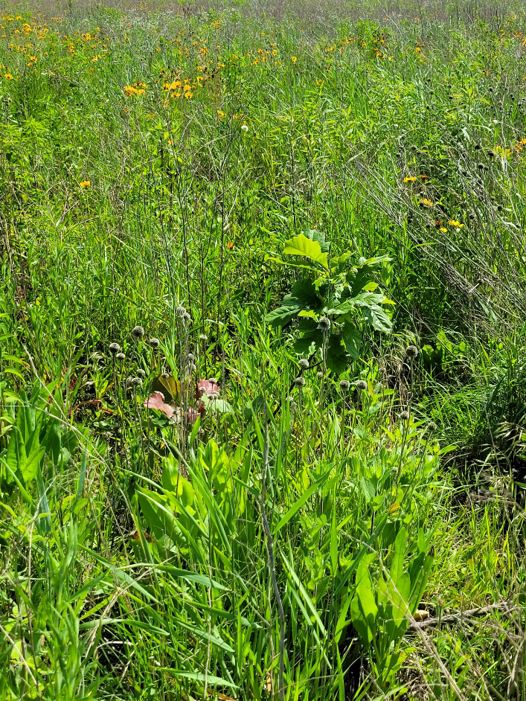
What to expect…
City Forest Credits and
Chicago Region Forest Credits overview
Case Study – Planting Project
Fox River Bluffs Forest Preserve Cropland Conversion
Case Studies – Land Conservation
Fitzgerald Road
Reservation Woods Acquisition Project
Crowley Oaks
Why sell carbon credits?
Q&A
Notes:
Introduce Panel, and offer overview of what we will cover, starting with an overview of the CFC program

Slide 3
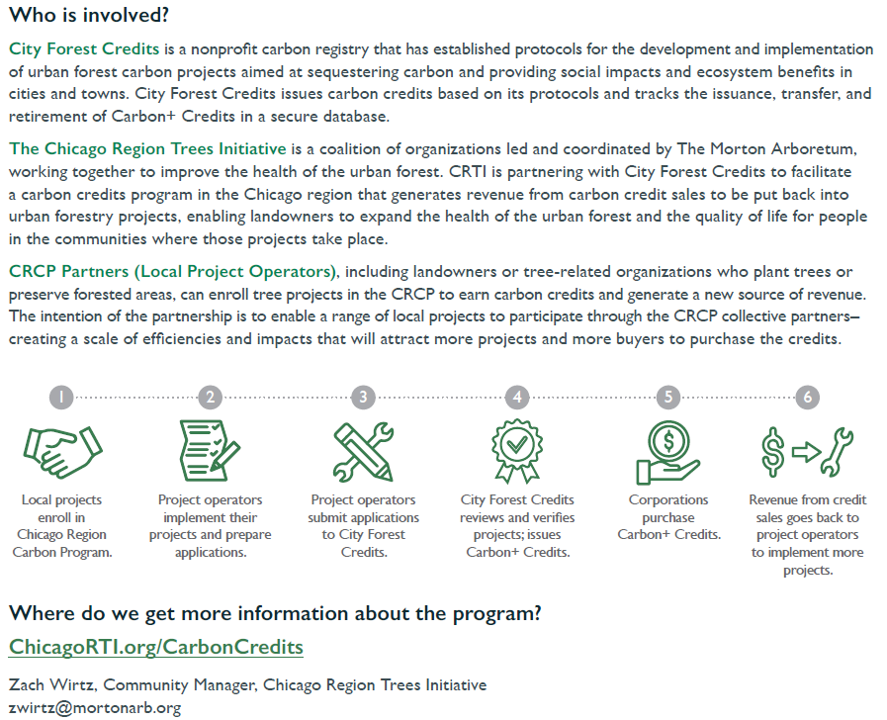
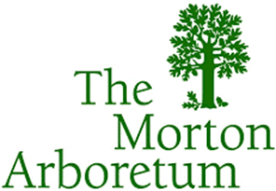


Slide 4

About City Forest Credits
Generating new carbon revenue and high-quality projects for greener, healthier, and more equitable cities
National 501(c)(3) nonprofit carbon registry
Connect urban forest leaders to new source of funding
Empower companies to invest in local climate action

Slide 5
About Chicago Region Carbon Program
Program of CRTI/Morton Arboretum, working with City Forest Credits
Provide opportunities to earn carbon credits from tree planting and preservation
Efficiently enroll planting and preservation projects into a region-wide carbon crediting program.
Notes:
CRTI introduced CFC to the Chicago region, and CFC found it to be a good fit. They have created a unique niche to certify and sell credits on urban forests that are being preserved as well as tree planting projects in urban areas. One reason for this is that the businesses who are the most likely participants in the voluntary carbon market are US businesses – and what could be better than investing in climate resilience and mitigation in the US in locations that provide direct benefits to local communities.

Slide 6
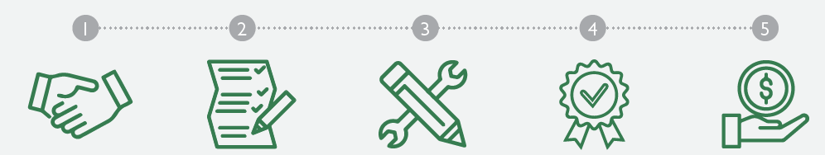
Chicago Region Carbon Program (CRCP)
CRTI recruits local projects for CRCP | Local Project Implementers prepare application and project info | Local Project Implementers submit project docs | CFC reviews, obtains third-party verification, and issues credits | CRTI or others sell credits
Notes:
The process is well organized, and they are now going in to their 3rd year.

Slide 7

Project Eligibility
Types (Planting v/s Preservation)
  Preservation – 10-acre minimum; zoning + threat from development
  Planting – 3 to 5-acre minimum
CRTI Initial Consultation
Application Submission to CFC or CRTI
Evaluation of Carbon Credits+™
  Completion of Third-Party Certification

Slide 8
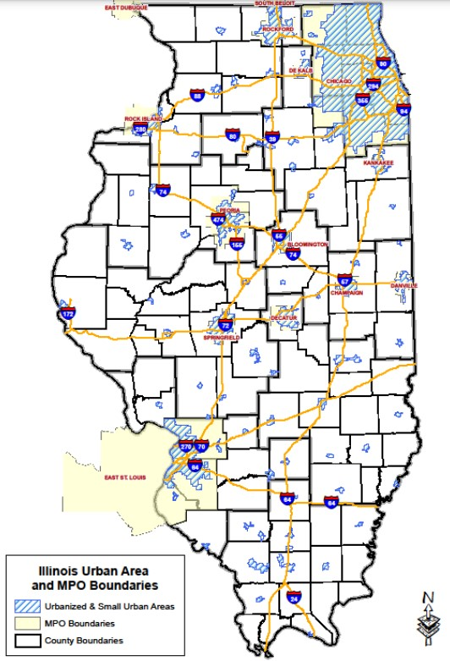
CFC Project Eligibility
The project location must meet one of six qualifying criteria which include being located in or adjacent to a municipality or located in an Urban Area or a regional metro planning area such as CMAP and the Region 1 Planning Council around Rockford.
Under threat of conversion to non-forest use, with at least 30% of surrounding land uses non-forest/developed uses that can include agricultural land
Not yet protected
Acquired within the last two 2 years
Notes:
Want to point out that while the case studies are all located in northern Illinois, it is certainly possible that CFC could work directly with organizations in other urban areas in Illinois – those groups just might not have the benefit of facilitation by CRTI/TMA.

Slide 9
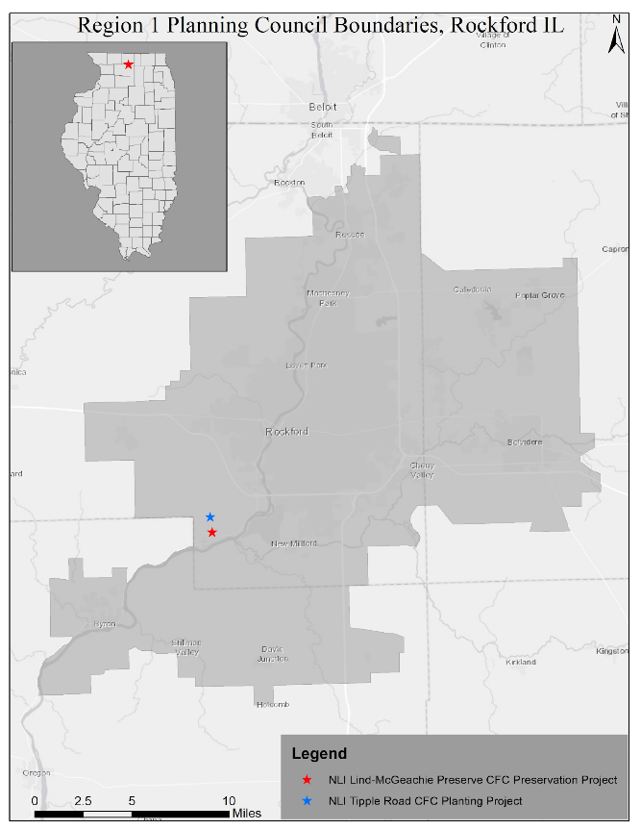
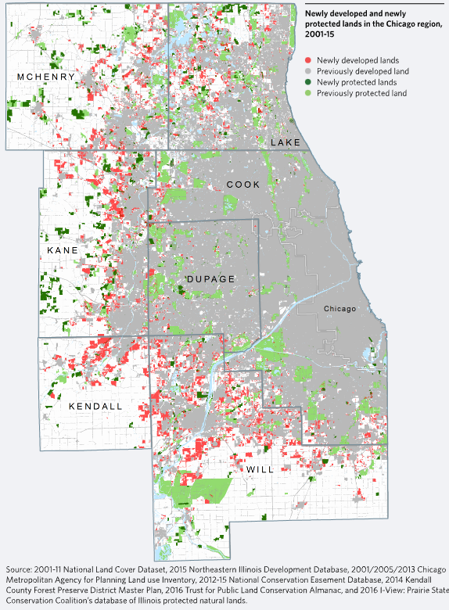

Crowley Oaks
Thompson Road
Fox River Bluffs
Reservation Woods
Notes:
Location of projects that we’ll be discussing – 4 in the CMAP service area, and one in the metro Rockford Planning area

Slide 10
2022 CRCP Carbon Projects
Organization | Project Type | Project Name | Credit Total | Estimated Revenue @ $34/credit
City of Highland Park | Planting | Urban Forest Rejuvenation | 160 in 2023 1,604 over 26 years | $5,440 (in 2023) %54,536 (lifetime)
Village of Mt. Prospect | Planting | Village of Mount Prospect Planting Project 2022 | 284 in 2023 2,845 over 26 years | $9,656 (in 2023) $96,730 (lifetime)
Land Conservancy of McHenry County | Preservation | Thompson Road Oak Woods | 6,897 | $234,498
Land Conservancy of McHenry County | Preservation | Crowley Oaks Conservation Area | 7,709 | $262,106
Kendall County Forest Preserve District | Preservation | Reservation Woods | 2,082 | $70,788
Natural Land Institute | Preservation | Fitzgerald Road | 3,230 | $109,820
Notes:
Here are the Illinois projects in the 2023 sale. Now, let’s hear from Kendall County – they were the first entity in Illinois to sell credits through this program! Dave…

Slide 11
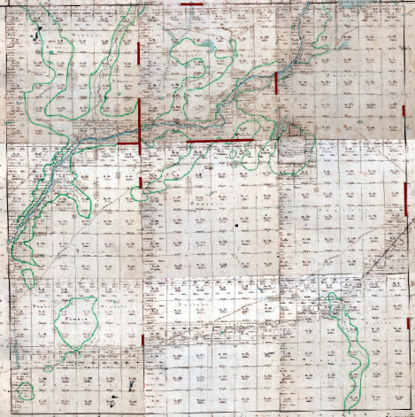
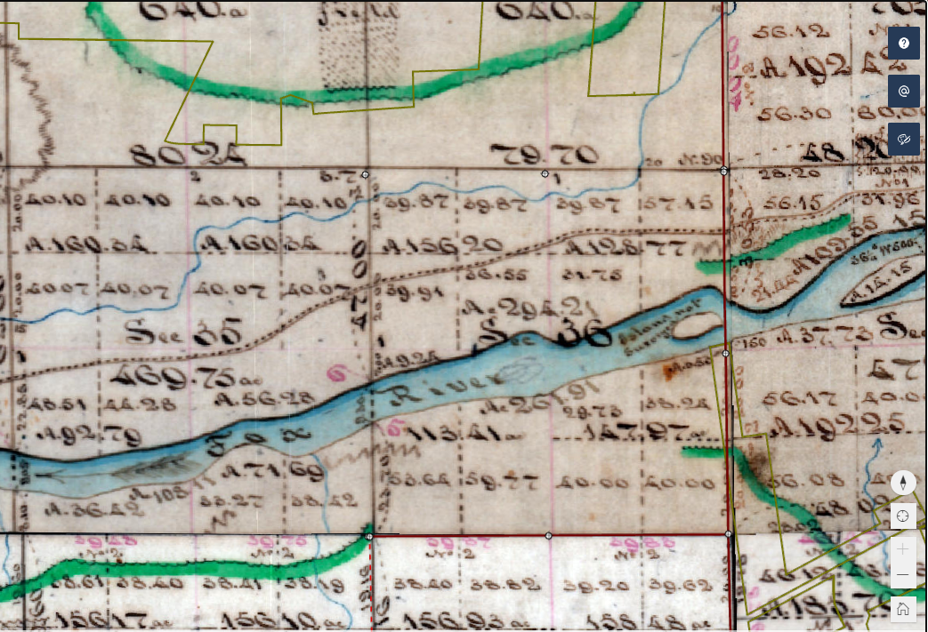
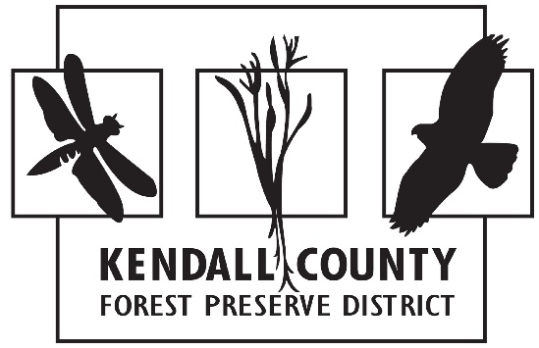
Case Study 1: Fox River Bluffs
Cropland Conversion Project

Slide 12
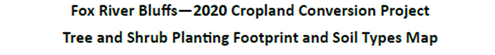
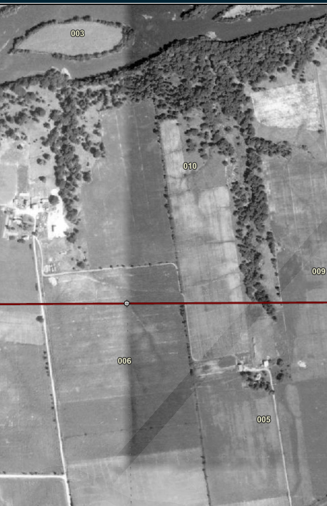
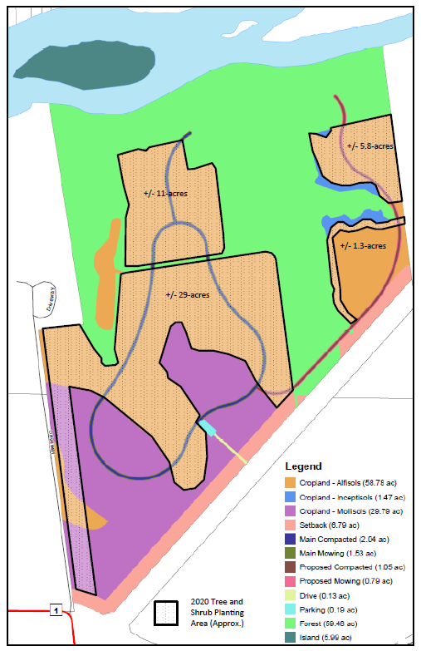
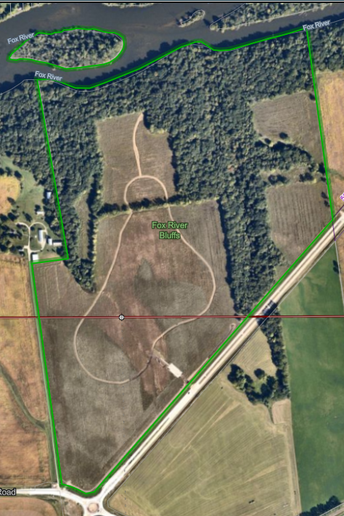
1939
2022

Slide 13
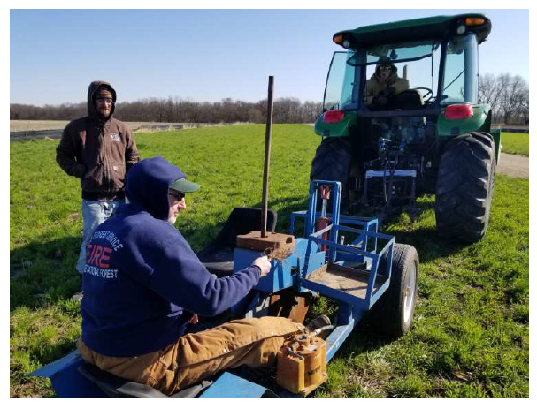
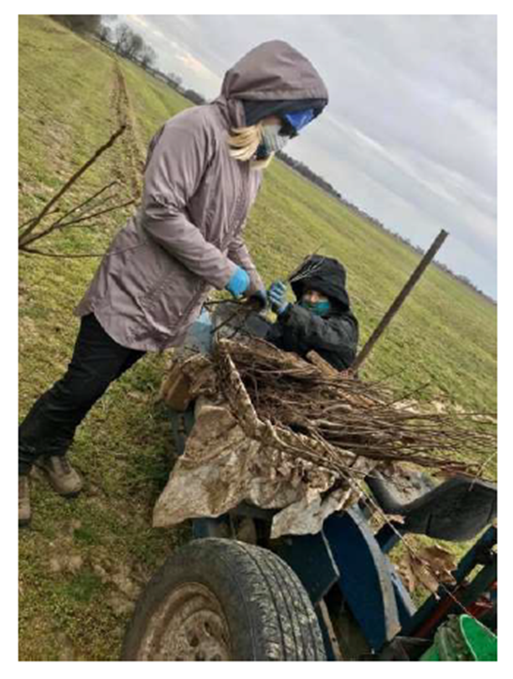
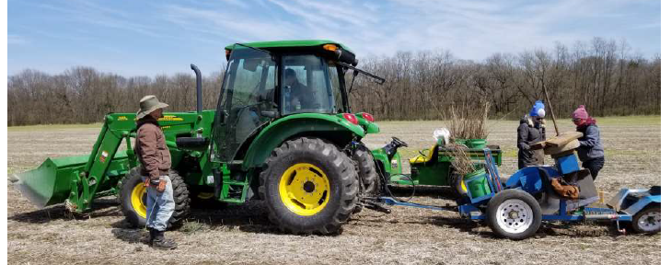

Slide 14
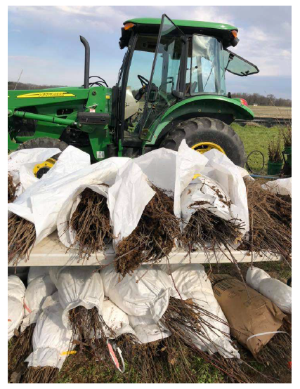
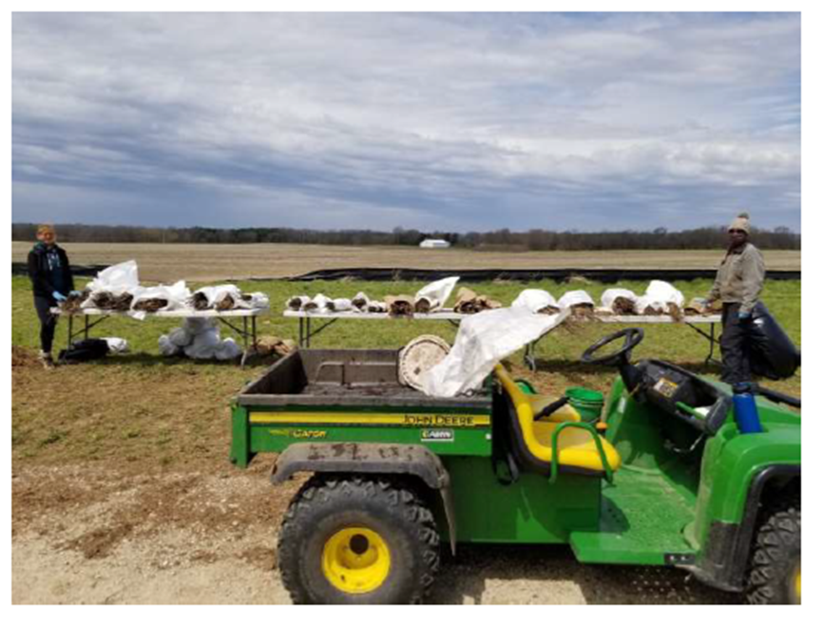

Slide 15
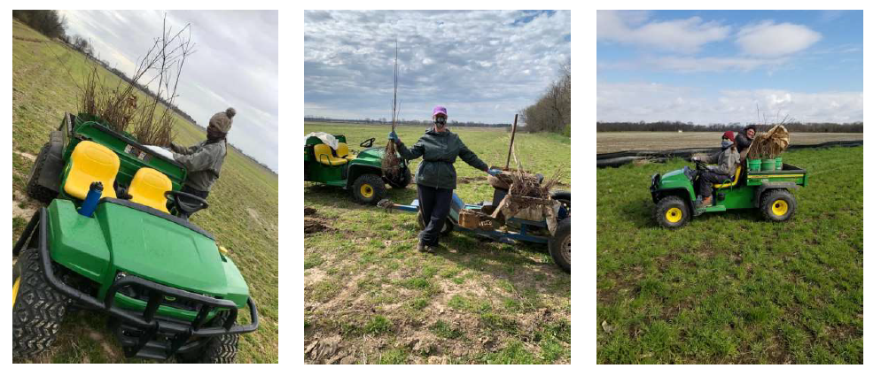

Slide 16
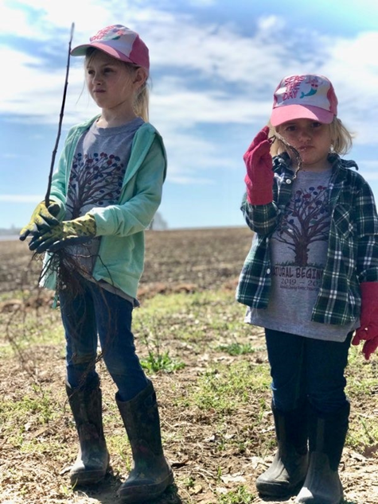
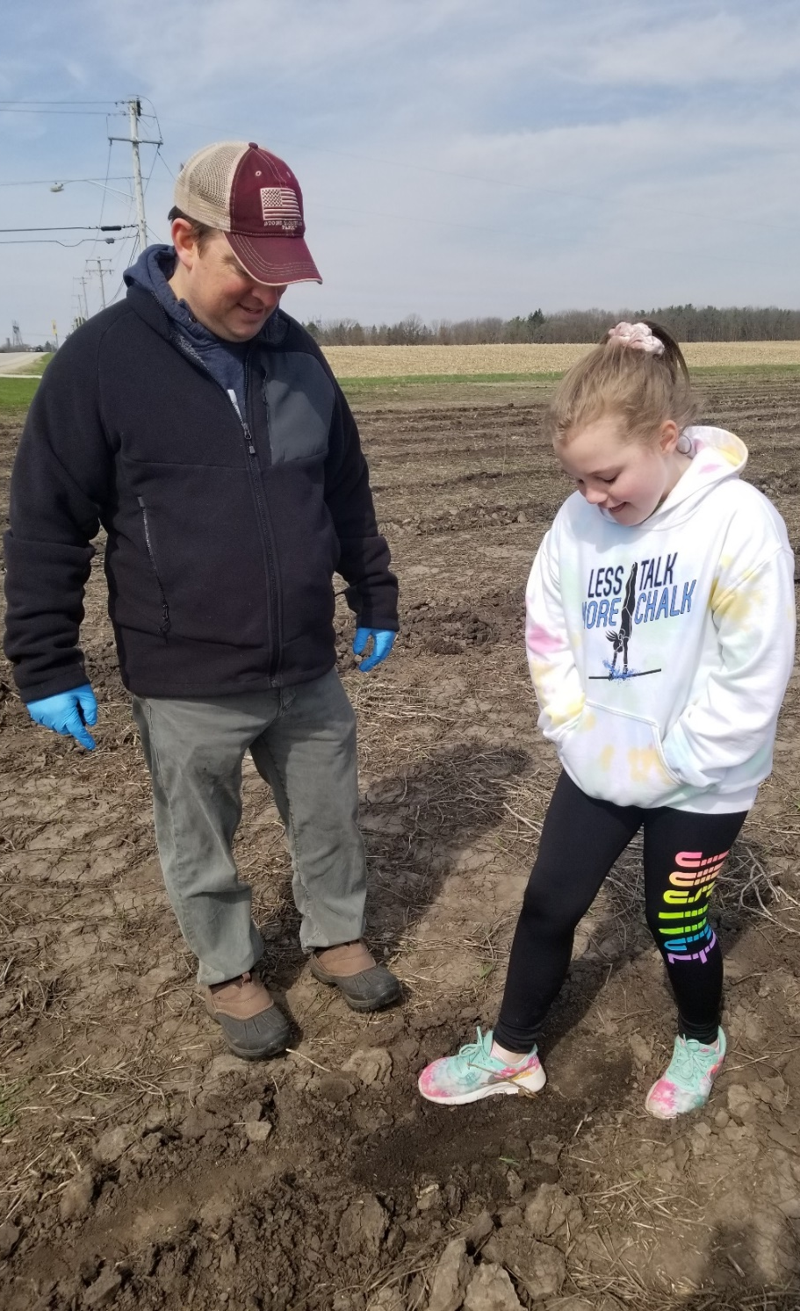
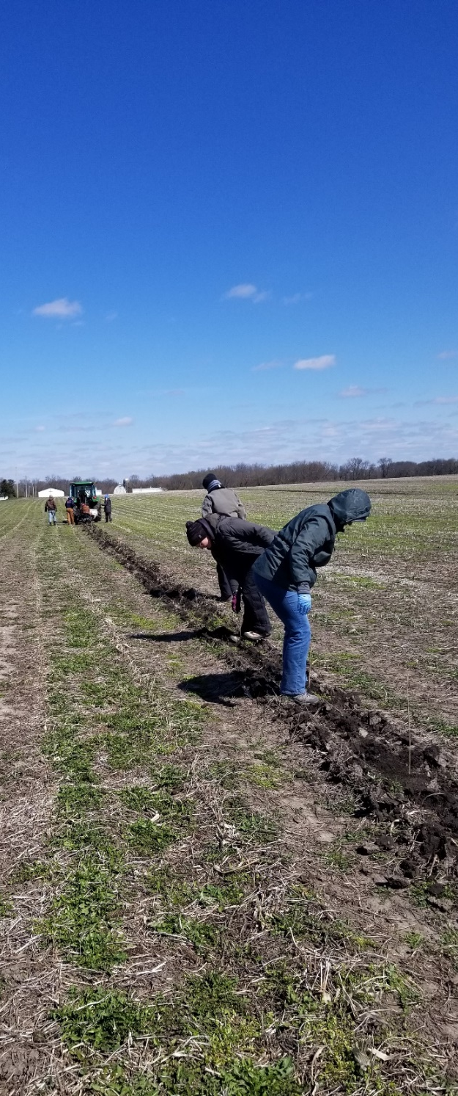

Slide 17
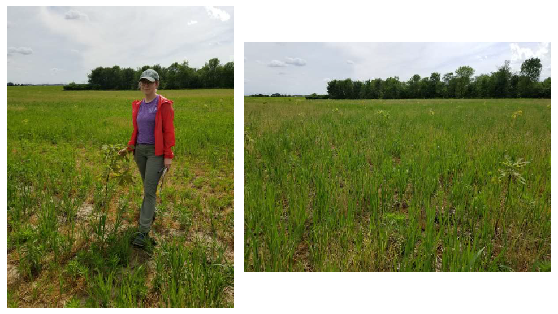

Slide 18
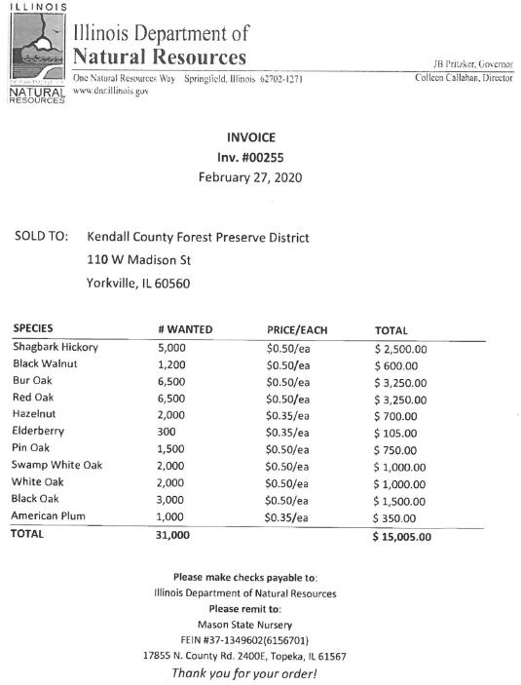
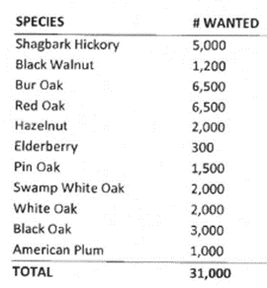

Slide 19
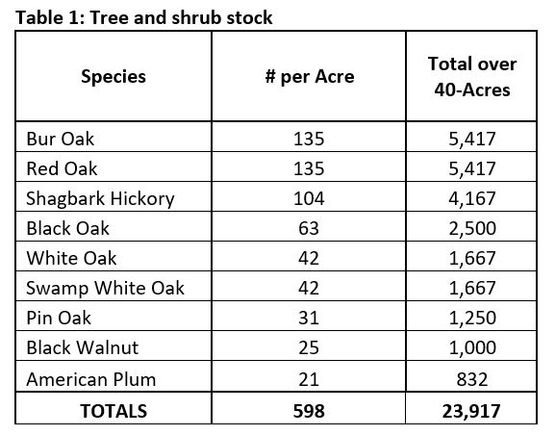

Slide 20
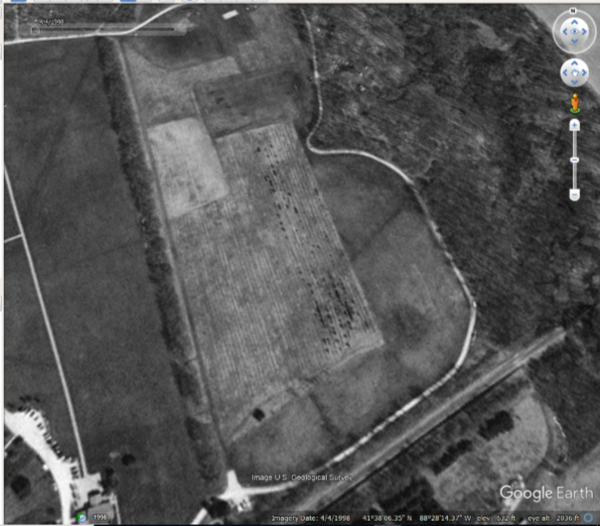
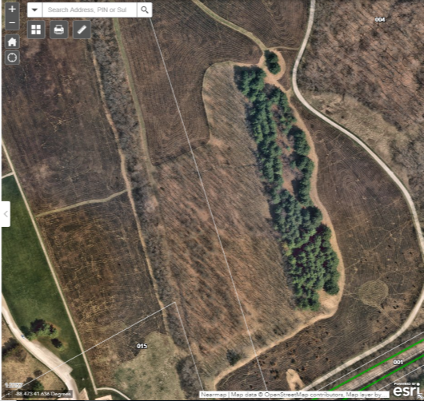

Slide 21
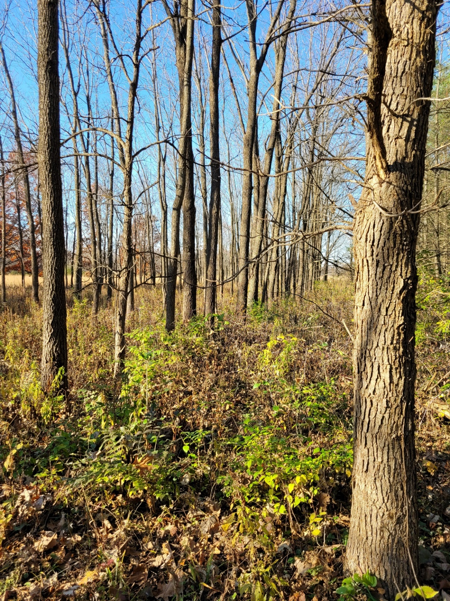
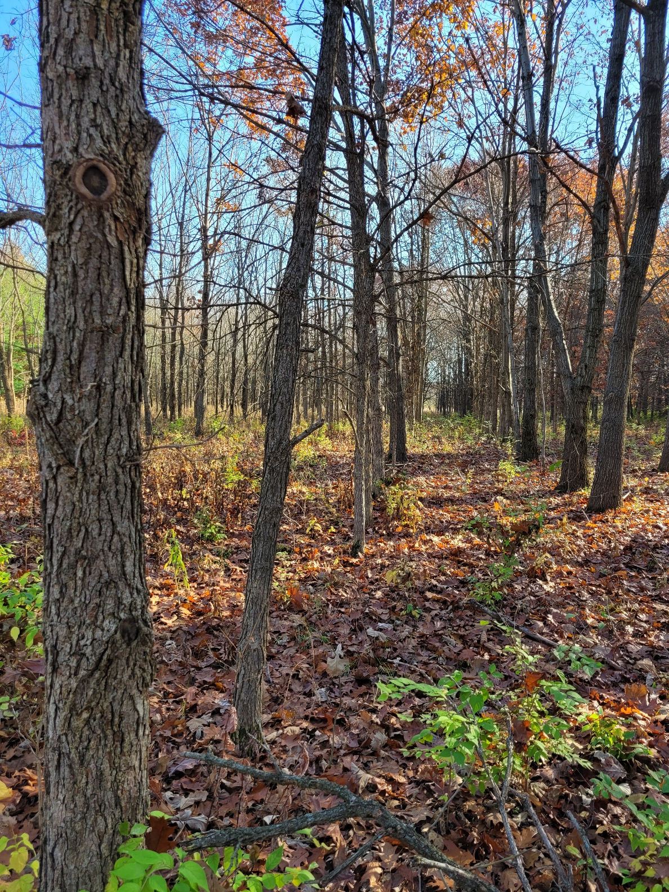

Slide 22
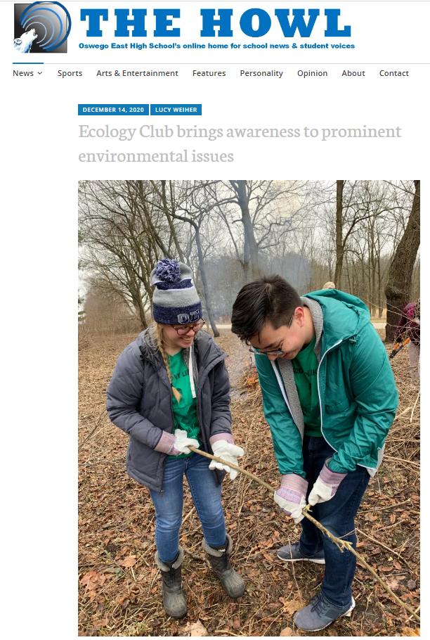
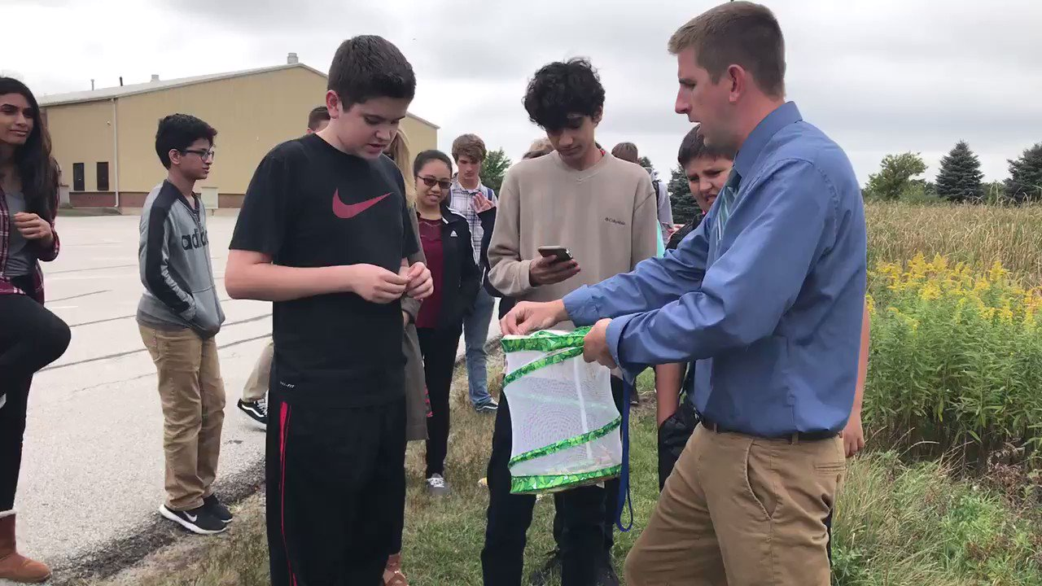

Slide 23
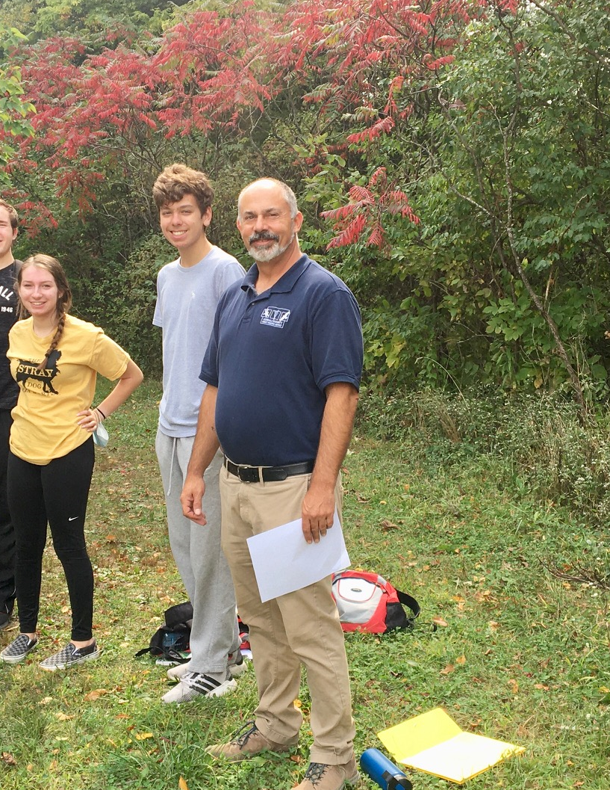
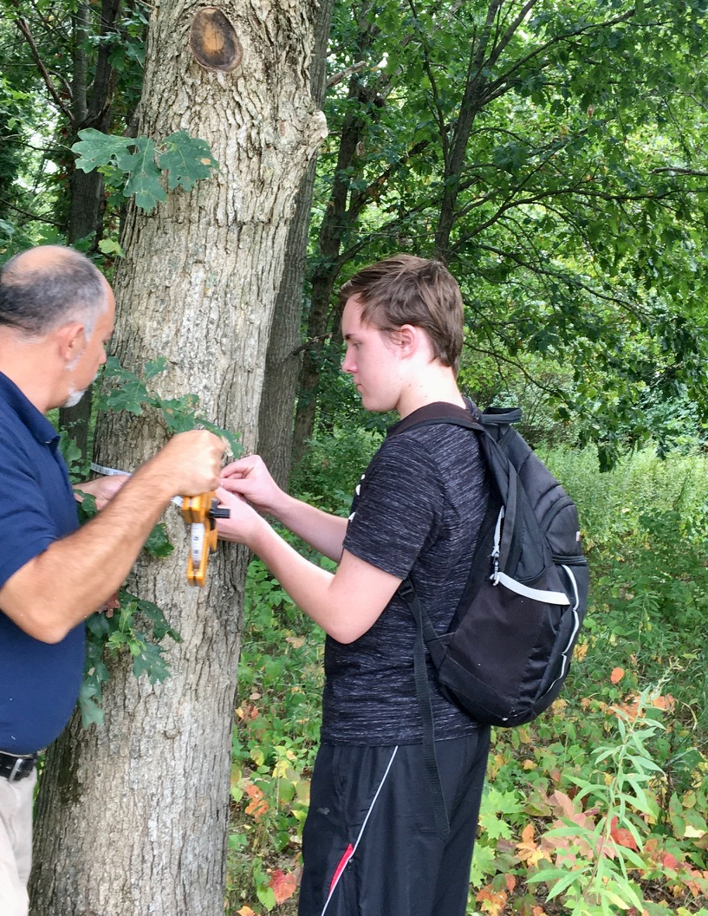

Slide 24
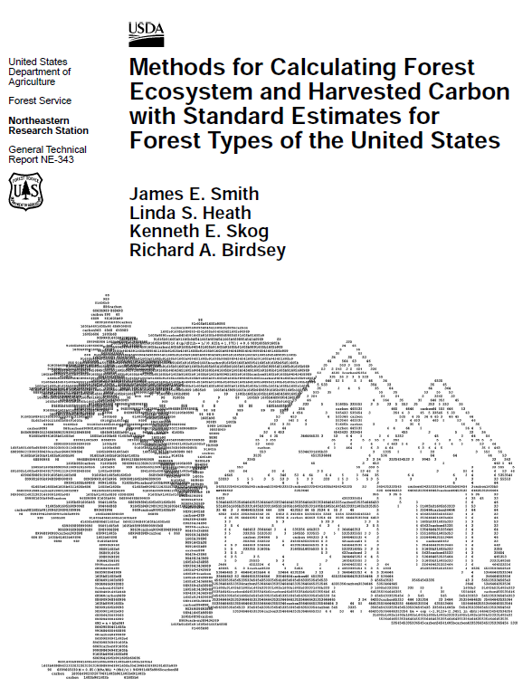
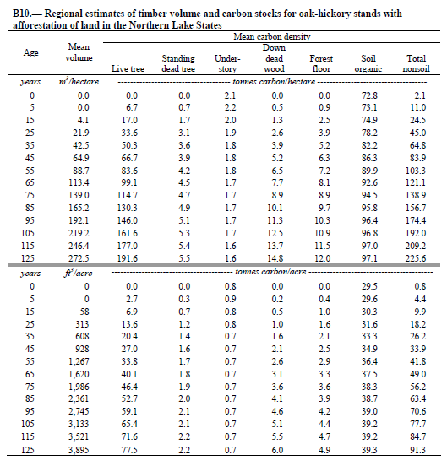
Hoover Forest Preserve Study
21.2 tons carbon/acre

Slide 26
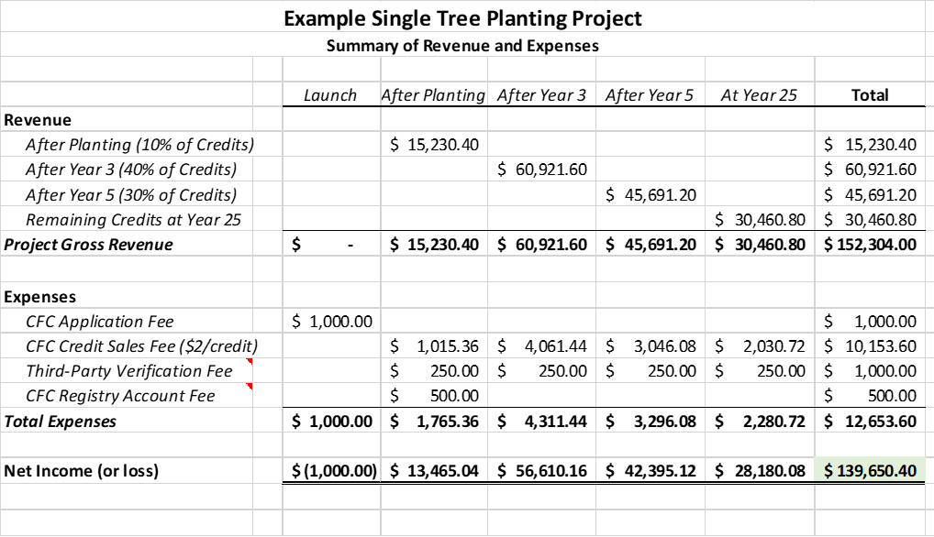

Slide 27

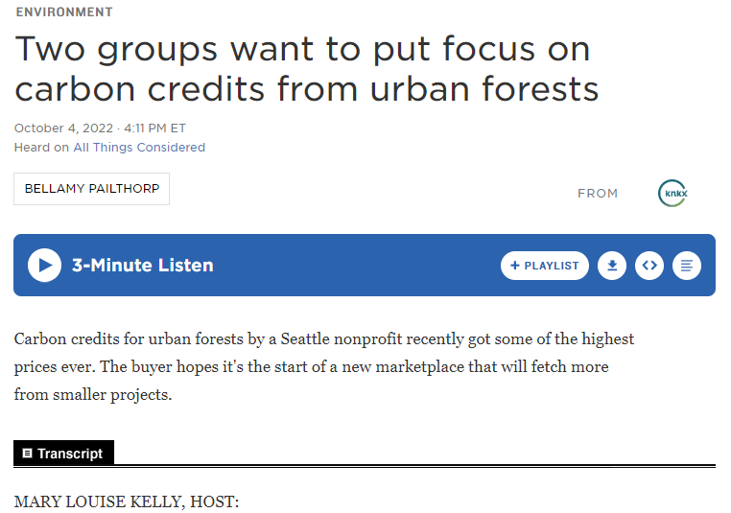

Slide 28
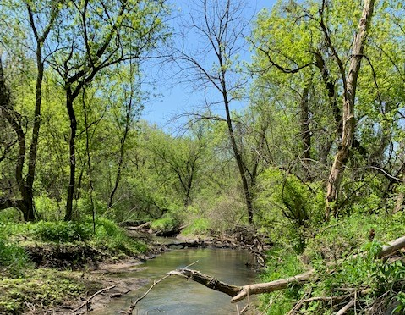
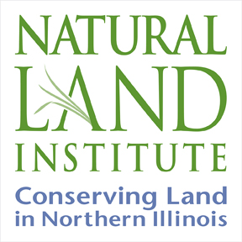

City Forest Credits
Case Study
This project is part of the Chicago Region Carbon Program (CRCP) supervised by the Chicago Region Trees Initiative.
Prairie State Conservation Coalition
March, 2023

Slide 29
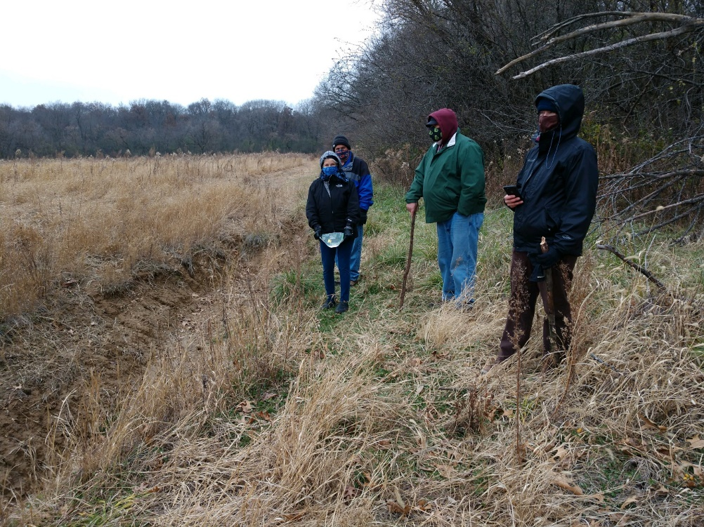
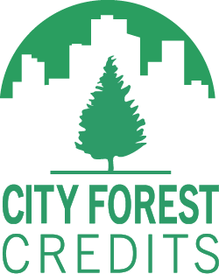
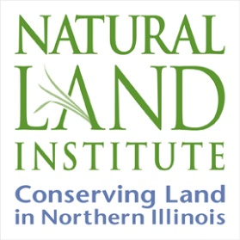
Why is NLI pursuing carbon credits?
NLI’s board wanted to explore several funding options for creating a sustainable land stewardship fund
Begin to create and grow a fund for land acquisition as grant funds are disappearing
Provide a mechanism of financial incentives to private landowners who want conservation easements with a way to fund their restoration activities
Other Benefits include:
Social equity, health, urban heat, bird and pollinator, and other human and community benefits
Quantifying ecosystem values in the form of stormwater reduction, improved air quality, and energy savings from cooling and heating impacts
Fitzgerald Rd. is NLI’s pilot project and we are also exploring other carbon credit programs that do not have the urban area requirement, such as Forest Carbon Works.
CFC is an independent non-profit carbon
Registry.

Slide 30
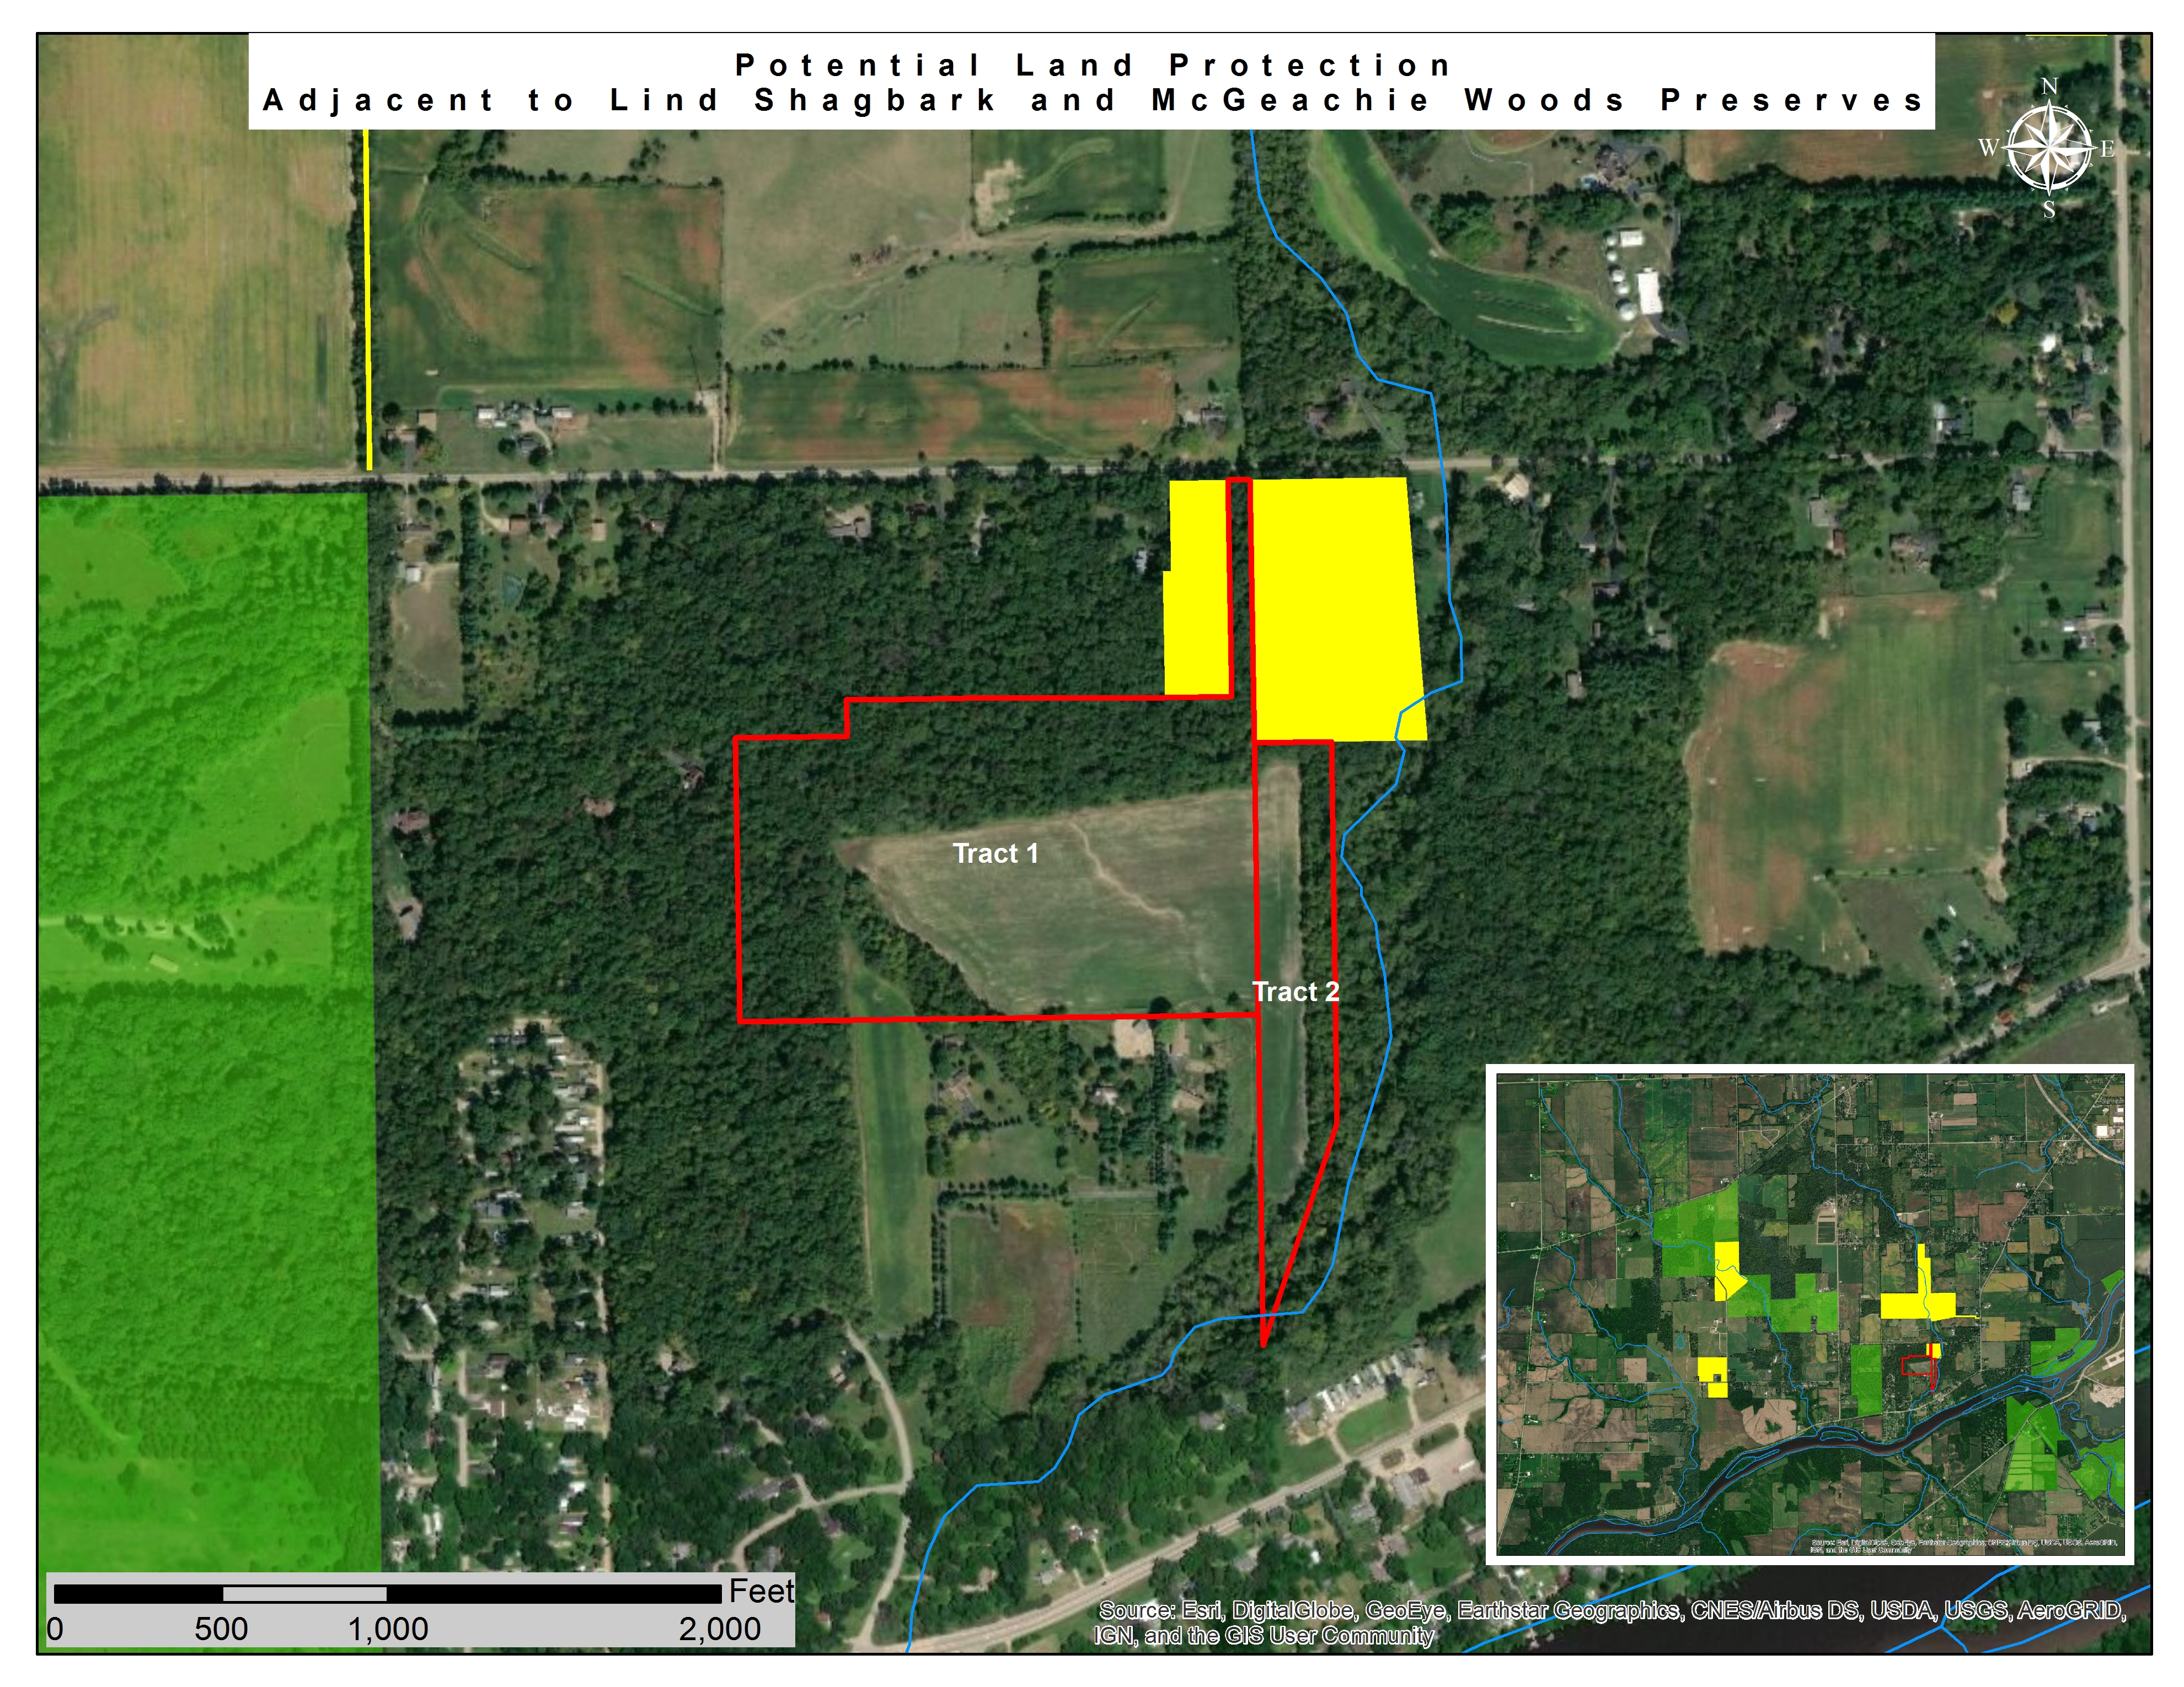
NLI Case Study:
Fitzgerald Road Site
City Forest Credits
Purchased the 42 acre Fitzgerald Road tracts in 2020
Connected and expanded the Lind-McGeachie sites into one preserve
Part of a complex of protected lands

Slide 31
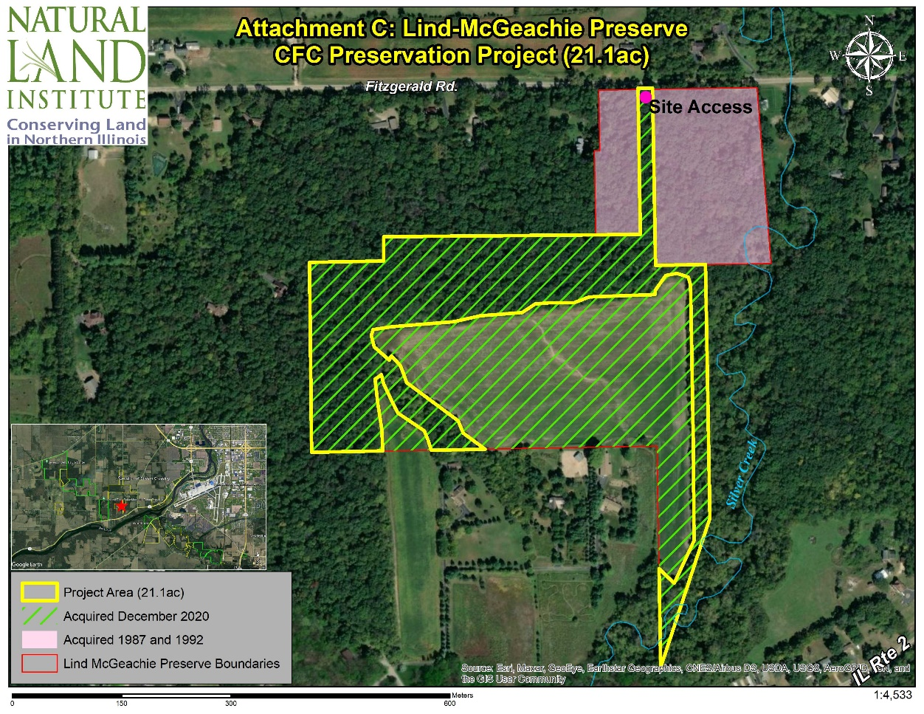
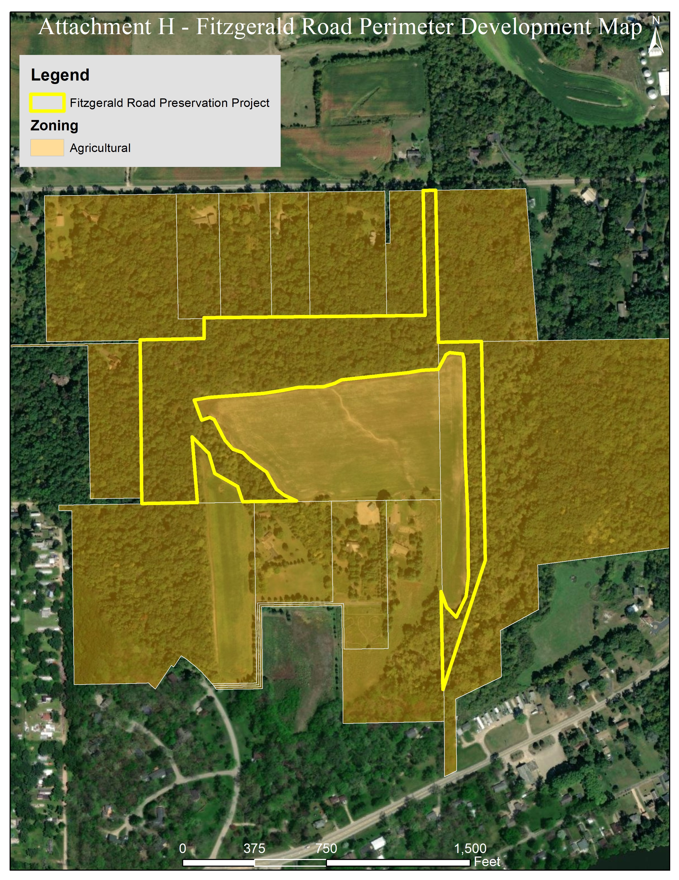
Project Site
There are 9 acres of mature, ~150 year old trees in the northern portion, 7.85 acres of ~95 year old trees mainly in the western portion and 4.25 acres in the west and eastern portions of ~75 year old trees
Identified as Critical/Sensitive Area” for “Priority Acquisition” in the 2015 Greenways Plan for Boone and Winnebago County

Slide 32
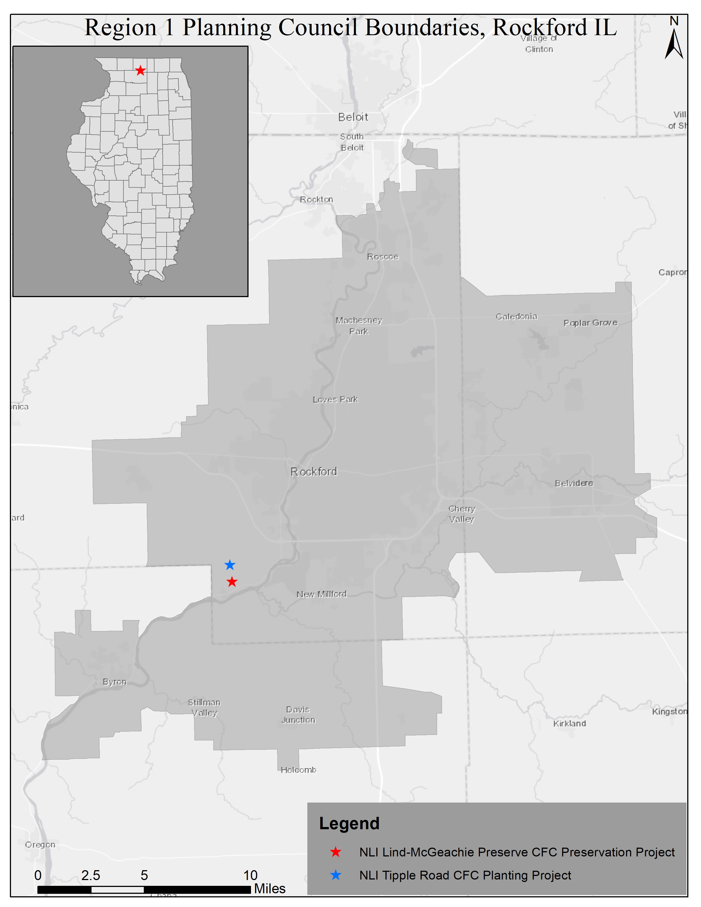
CFC Project Eligibility
Located in the Region 1 Planning Council (R1PC) of Rockford and surrounding area (Urban designation; 1 of 6 criteria to choose from)
Under threat of agricultural and residential development
Not yet protected
Acquired within the last two 2 years

Slide 33


Preparation of Application Documents
About 40 hours of staff time plus map making by David Holman (Jill getting)

Slide 34

Ecosystem Services
Project Area: 21.1 forested, developable acres
Forest: Oak Hickory, 91.4% canopy cover
  The urban forest of Fitzgerald Road has an estimated 2,985 trees with a tree cover of 91 percent. The three most common species are Black cherry (22.6 percent), Shagbark hickory (19.2 percent), and American elm (18.5 percent).
Zoning: Agricultural Priority ‘AG’
Carbon+ Credits (tons CO2(e)):
  3,589 credits attributed to project
  359 credits for Registry Reversal Pool
  3,230 credits issued to project

Slide 35



Then The Next Steps:
Carbon Quantification and Third Party Verification
On the CFC Website
3,230 CREDITS ISSUED!!!!!!
Apply to become part of the National Sale of the Credits for CFC
An immediate portfolio of 18 U.S. urban forest planting and preservation projects comprising 79,000 high quality carbon credits
https://www.cityforestcredits.org/carbon-credits/carbon-registry/

Slide 36

Board Approval
Total Credits Issued to the Project, tCO2e: 3,230
Total Additional Growth Credits (Year 20): 2,871
Total Additional Growth Credits (Year 40): 2,871
credit sales may be standardized and automated in the future so that this labor intensive, manual process is replaced by something easier and cheaper.

Slide 37

Monitoring Requirements
Due every 3 years at anniversary of the Third-Party Verification Report.
Must include imaging. If imaging shows net tree loss of greater than 8% of canopy, CFC requires further investigation.
This is a public document posted on the CFC Registry.

Slide 38


Case Study 2: Reservation Woods
Acquisition Project (10.0869-acres)

Slide 39


Slide 40

Increasing Threats from Residential Development

Slide 41



Slide 42



Slide 43


Slide 44


Slide 45


Case Study
Crowley Oaks
Site: 45-acre oak-hickory woodland that is part of the largest unprotected remaining oak woods in McHenry County.
Goal: preserve and restore the entire oak woodland complex for the benefit of woodland birds and wildlife
Project Impacts:
  provide a habitat anchor for several bird species that are considered species of concern (e.g. red-headed woodpecker)
  Provide recreation opportunities and connect residents to nature
  Protect woodland habitat and prevent fragmentation

Slide 46


Slide 47


Slide 48

Project Details
Details:
  zoned for agricultural use, and surrounding land use is a combination of farmland and large-lot residential development.
Carbon+ Credits: 7,709
Co-Benefits: $112,638.68/year for 40 years
Commitments:
  Monitor and track forest health, submit report every three years for 40 years
City Forest Credits

Slide 49

Crowley Oaks
Ecosystem Services | Resource Units | Value
Rainfall Interception (m3/yr) | 12,172.9 | $87,156.20
Air Quality (t/yr) | 0.5095 | $767.10
Cooling – Electricity (kWh/yr) | 95,825 | $7,273.08
Heating – Natural Gas (kBtu/yr) | 1,791,752 | $17,442.30
Grand Total ($/yr) |  | $112,638.68
Species (most abundant on site) | Number of Trees | Carbon storage | Average C per tree
White oak | 395 | 562 metric tons | 1.42 mt
Pin oak | 1,227 | 417 metric tons | 0.34 mt
Bur oak | 273 | 358 metric tons | 1.31 mt
Shagbark hickory | 505 | 51 metric tons | 0.10 mt
Black cherry | 2,059 | 428 metric tons | 0.21 mt
American elm | 927 | 79 metric tons | 0.09 mt
Green ash | 423 | 39 metric tons | 0.09 mt

Slide 50

Why did TLC decide to sell credits on two oak woodlands?
It is consistent with our mission and goals
  Preserve the trees for 40 years
  Monitor property every 3 years
Provides funds for long-term management
  These are hard funds to raise
Possible tool for private woodland preservation
  Landowners are reluctant to donate easements on their woodlands, but may be willing to sell carbon credits in exchange for a 40-year restriction

Slide 51

What you need to know…
The land needs to have been acquired recently, and it cannot be encumbered with an easement or other development restriction.
The application takes time, but it isn’t complicated – just thorough. It is very much like filling out a grant application.
There are up-front expenses:
  $1,500 registration
  $3,000 for 3rd party verification of carbon credits
  $1,000 account fee for the credit registry account
  Also there would usually be a cost for having the property evaluated and the carbon credits determined, but The Morton Arboretum had grant funds to cover this since program is new. (estimated $6-10K expense)

Slide 52


Opens opportunities…
Preserve more oaks
  Knowing that there is a mechanism for generating long-term management funds makes the decision to purchase additional oak woodlands much easier.
  We hope to use our experience to inspire some private landowners to sell carbon credits on their woods.

Slide 53

Questions?

